Slide 1
Memory Management
Program must be brought (from disk) within a process for it to be run
into memory and placed
Main memory and the registers built into each processing core are
the only general-purpose storage that the CPU can access directly.
Memory unit only sees a stream of:
addresses + read requests, or
address + data and write requests
Register access is done in one CPU clock (or less)
Main memory can take many cycles, causing a stall
Cache sits between main memory and CPU registers
For proper system operation, to protect the operating system from access by user processes, as well as protect user processes from one another. This protection must be provided by the hardware, because the operating system doesn‘t intervene between the CPU and its memory accesses

Slide 2
Protection
Each process has a separate memory space. Separate per-process
memory space protects the processes from each other
To separate memory spaces, to determine the range of legal addresses that the process may access and to ensure that the process can access only these legal addresses.
To provide this protection by using two registers, a base and a limit
The base register holds the smallest legal physical memory address; the limit register specifies the size of the range.
For example, if the base register holds 300040 and the limit register is 120900, then the program can legally access all addresses from 300040 through 420939

Slide 3
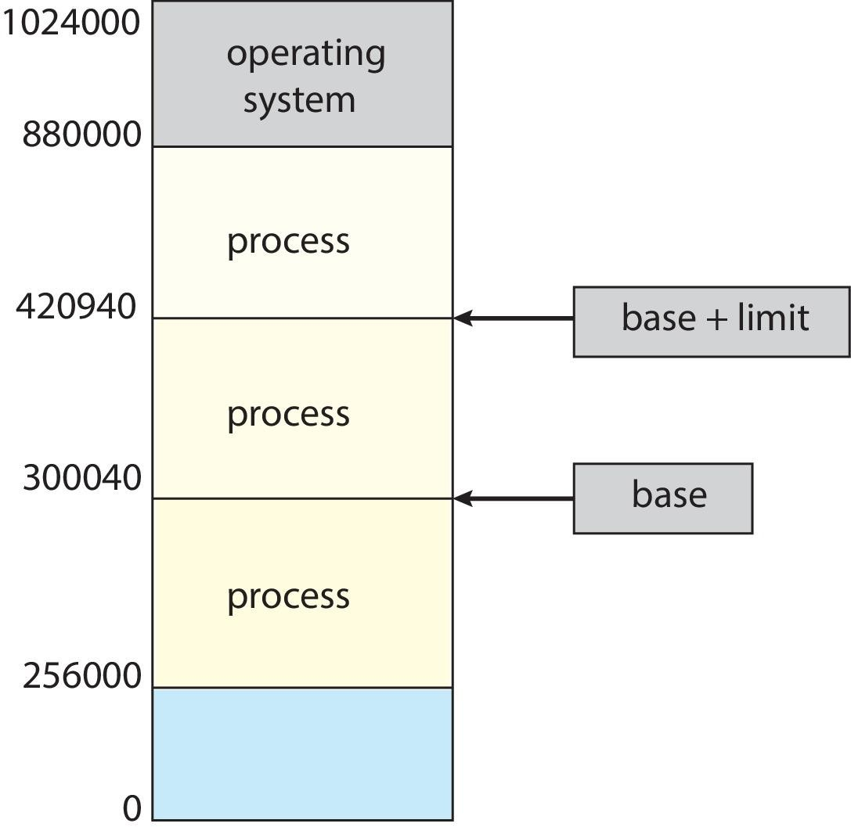
Protection of memory space is accomplished by having the CPU compare every address generated in user mode with the registers. Any attempt by a program executing in user mode to access operating-system memory or other users‘ memory results in a trap to the operating system, which treats the attempt as a fatal error. This scheme prevents a user program from (accidentally or deliberately) modifying the code or data structures of either the operating system or other users.

Slide 4
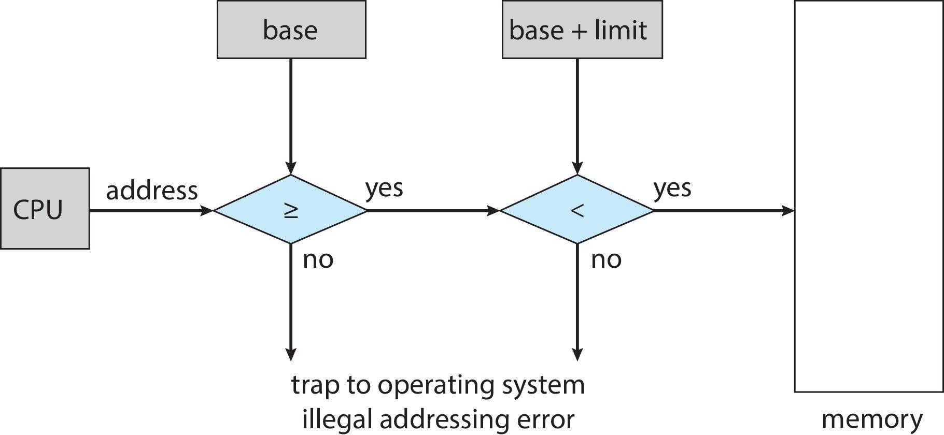
Hardware Address Protection
CPU must check every memory access generated in user mode to be sure it is between base and limit for that user
The base and limit registers can be loaded only by the operating
system, which uses a special privileged instruction.

Slide 5
Address Binding
Addresses may be represented in different ways during these steps
Source program : Addresses in the are generally symbolic (such as the variable count, MAX, MIN).
Compiler : Typically binds these symbolic addresses to relocatable addresses (such as ―14 bytes from the beginning of this module‖).
Linker or loader : Binds the relocatable addresses to absolute
addresses (such as 74014).
Each binding is a mapping from one address space to another.
Programs on disk, ready to be brought into memory to execute from
an input queue
Input Queue→ Select a process → Loads it into memory → Executes and accesses instructions and data from memory → Process terminates → memory space is declared available→ memory is reclaimed for use by other processes

Slide 6
Binding of Instructions and Data to Memory
Address binding of instructions and data to memory addresses can happen at three different stages
Compile time: If we know at compile time where the process will reside in memory, then absolute code can be generated. For example, if we know that a user process will reside starting at location R, then the generated compiler code will start at that location and extend up from there. If, at some later time, the starting location changes, then it will be necessary to recompile this code.
Load time: If it is not known at compile time where the process will reside in memory, then the compiler must generate relocatable code. In this case, final binding is delayed until load time. If the starting address changes, we need only reload the user code to incorporate this changed value.
Execution time: If the process can be moved during its execution from one memory segment to another, then binding must be delayed until run time. Special hardware is required for this scheme to work.

Slide 7
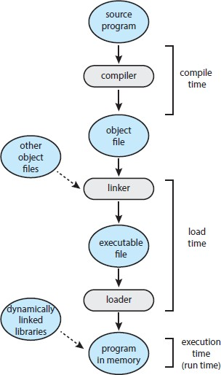
Multistep Processing of a User Program

Slide 8
Logical vs. Physical Address Space
Logical address : An address generated by the CPU
Physical address : An address seen by the memory unit—that is, the
one loaded into Memory Address Register [MAR] of the memory
Compile or Load time address binding generates identical logical and physical addresses [or] Logical and physical addresses are the same in compile-time and load-time address-binding schemes;
Execution-time address-binding scheme results in differing logical and physical addresses. In that case, logical address is referred as virtual address
Logical address space is the set of all logical addresses generated by
a program
Physical address space is the set of all physical addresses corresponding to those logical addresses

Slide 9
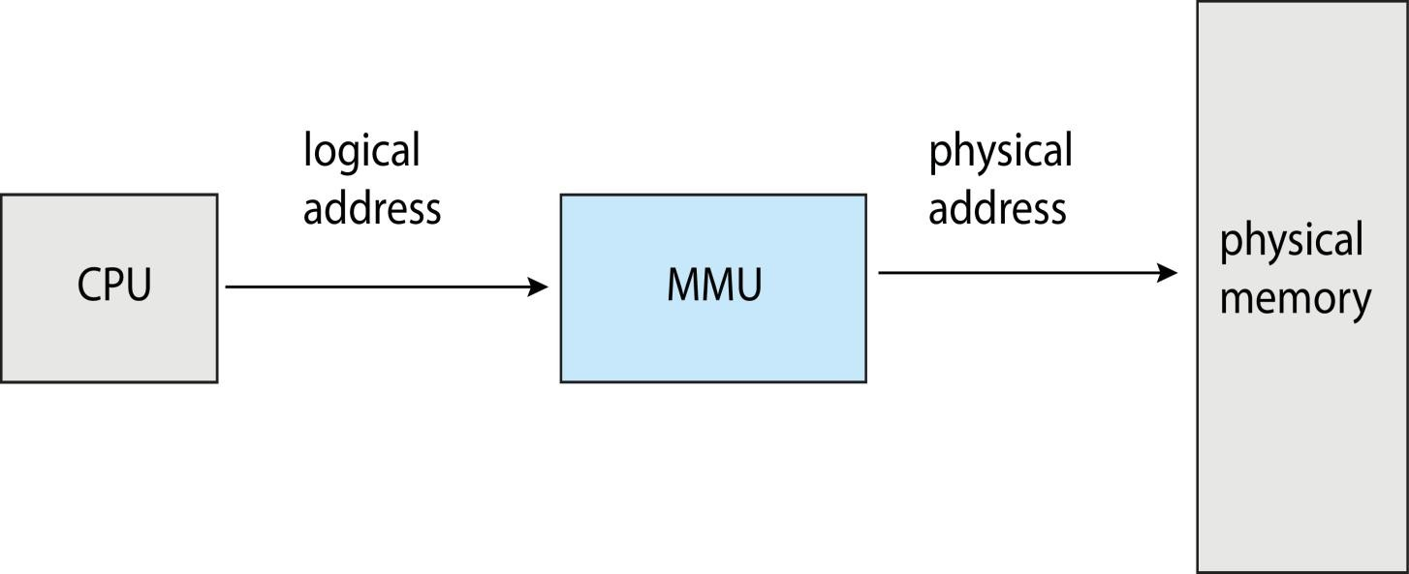
Memory-Management Unit (MMU)
The run-time mapping from virtual to physical addresses is done by a hardware device called the memory-management unit (MMU)
Many different methods to accomplish such mapping. One technique is mapping with a simple MMU scheme that is a generalization of the base register scheme.
Logical addresses (in the range 0 to max) and physical addresses (in the range R + 0 to R + max for a base value R). The user program generates only logical addresses and thinks that the process runs in memory locations from 0 to max. However, these logical addresses must be mapped to physical addresses before they are used.

Slide 10
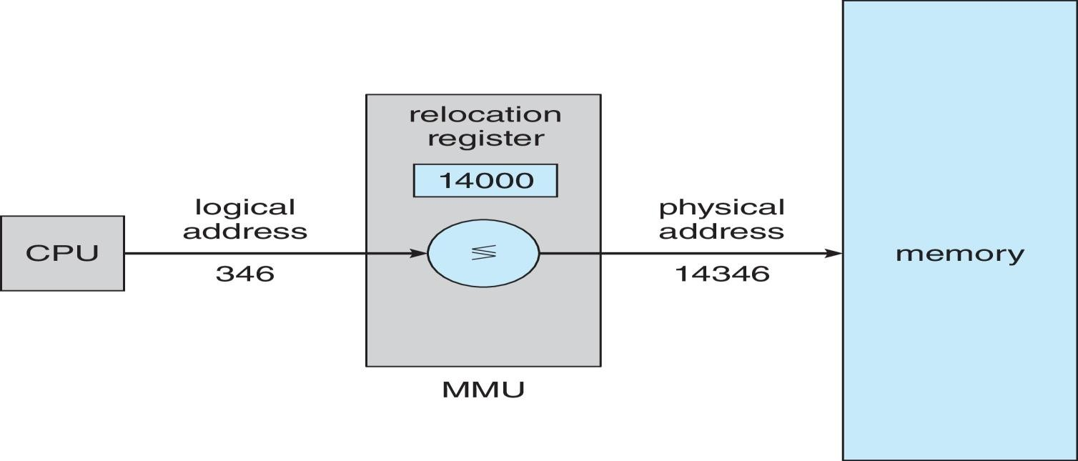
Memory-Management Unit (Cont.)
The base register now called relocation register
The value in the relocation register is added to every address
generated by a user process at the time it is sent to memory
The user program deals with logical addresses; it never sees the real
physical addresses
Execution-time binding occurs when reference
location in memory
Logical address bound to physical addresses
is made to

Slide 11
Dynamic Loading
Entire program and all data of a process to be in physical memory for the process to execute. The size of a process has thus been limited to the size of physical memory. To obtain better memory-space utilization, use dynamic loading.
In dynamic loading, a routine is not loaded until it is called. All routines are kept on disk in a relocatable load format. The main program is loaded into memory and is executed. When a routine needs to call another routine, the calling routine first checks to see whether the other routine has been loaded. If it has not, the relocatable linking loader is called to load the desired routine into memory . Then control is passed to the newly loaded routine.
Routine is not loaded until it is called is the advantage of dynamic loading; Better memory-space utilization; unused routine is never loaded. Useful when large amounts of code are needed to handle infrequently occurring cases; No special support from the operating system is required- Implemented through program design - OS can help by providing libraries to implement dynamic loading

Slide 12
Dynamic Linking and Shared Libraries
Dynamically linked libraries (DLLs) are system libraries that are linked to user programs when the programs are run
Static linking – system libraries and program code combined by the loader into the binary program
Dynamic linking –linking postponed until execution time.
Advantages of DLL:
If DLL is not in the system, each program on a system must include a copy of its language library in the executable format. This requirement not only increases the size of an executable format but also waste main memory.
DLLs is that these libraries can be shared among multiple processes, so that only one instance of the DLL in main memory. For this reason, DLLs are also known as shared libraries, and are used extensively in Windows and Linux systems.

Slide 13
Small piece of code, stub, used to locate the appropriate memory- resident library routine or how to load the library if the routine is not already present.
When the stub is executed, it checks to see whether the needed
routine is already in memory
If not, the program loads the routine into memory
Either way, the Stub replaces itself with the address of the routine, and executes the routine
Thus, the next time that particular code segment is called, the library routine executed directly, incurring no cost for dynamic linking
Dynamically linked libraries can be extended to library updates (such as bug fixes). In addition, a library may be replaced by a new version, and all programs that reference the library will automatically use the new version. Versioning may be needed

Slide 14
Memory Partition
1. Contiguous Partition - Variable Partition - First Fit, Best Fit,
Worst Fit algorithms
1. Fixed same Size Partition - Paging

Slide 15
Contiguous Allocation
The main memory must accommodate both the operating system and
the various user processes
Limited resource, must allocate efficiently
Contiguous allocation is one early method
Main memory usually into two partitions:
Resident operating system, usually held in low memory or high memory
User processes then held in high memory
Each process contained in single contiguous section of memory

Slide 16
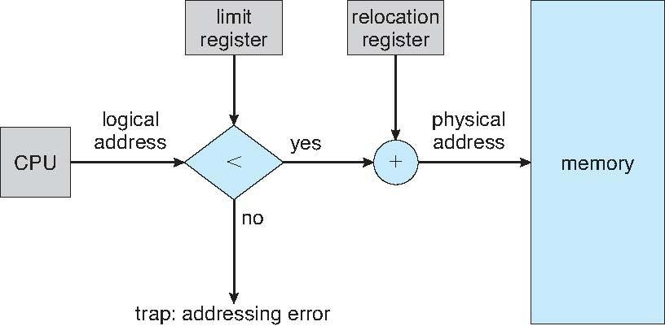
Memory Protection- Hardware Support for Relocation and Limit Registers
Prevent a process from accessing memory that it does not own. For
that, a system with a relocation register together with a limit register is used.
The relocation register contains the value of the smallest physical address; the limit register contains the range of logical addresses (for example, relocation = 100040 and limit = 74600). Each logical address must fall within the range specified by the limit register.
The MMU maps the logical address dynamically by adding the value
in the relocation register

Slide 17
When the CPU scheduler selects a process for execution, the dispatcher loads the relocation and limit registers with the correct values as part of the context switch.
Because every address generated by a CPU is checked against these registers, it protect both the operating system and the other users‘ programs and data from being modified by this running process.

Slide 18
Memory Allocation -Variable Partition
The simplest methods of allocating memory is to assign processes to
variably sized partitions in memory, where each partition may contain exactly one process.
In this variable partition scheme, the operating system keeps a table indicating which parts of memory are available and which are occupied.
Initially, all memory is available for user processes and is
considered one large block of available memory, a hole.
When a process arrives, it is allocated memory from a hole large enough to accommodate it
Process exiting frees its partition, adjacent free partitions combined
Operating system maintains information about:
a) allocated partitions b) free partitions (hole)

Slide 19
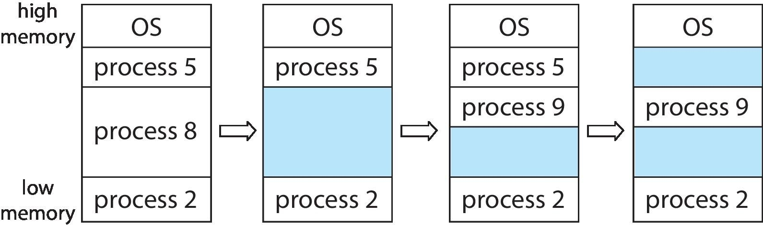
Initially, the memory is fully utilized, containing processes 5, 8, and 2. After process 8 leaves, there is one contiguous hole. Later on, process 9 arrives and is allocated memory. Then process 5 departs, resulting in two noncontiguous holes.
What happens when there isn‘t sufficient memory to satisfy the
demands of an arriving process? Two solutions
To simply reject the process and provide an appropriate error message.
Place such processes into a wait queue. When memory is later released, the operating system checks the wait queue to determine if it will satisfy the memory demands of a waiting process.

Slide 20
Dynamic Storage-Allocation Problem
In general, the memory blocks available comprise a set of holes of various sizes scattered throughout memory.
When a process arrives and needs memory, the system searches the set for a hole that is large enough for this process.
If the hole is too large, it is split into two parts. One part is allocated to the arriving process; the other is returned to the set of holes.
When a process terminates, it releases its block of memory, which is then placed back in the set of holes. If the new hole is adjacent to other holes, these adjacent holes are merged to form one larger hole.
This procedure is a particular instance of the general dynamic storage allocation problem, which concerns how to satisfy a request of size n from a list of free holes. There are many solutions to this problem. The first-fit, best-fit , and worst-fit strategies are the ones most commonly used to select a free hole from the set of available holes.

Slide 21
Dynamic Storage-Allocation Problem (continued)
How to satisfy a request of size n from a list of free holes?
First fit: Allocate the first hole that is big enough. Searching can start either at the beginning of the set of holes or at the location where the previous first-fit search ended. Stop searching as soon as find a free hole that is large enough.
Best fit: Allocate the smallest hole that is big enough. Search the entire list, unless the list is ordered by size. This strategy produces the smallest leftover hole.
Worst fit : Allocate the largest hole. Again, search the entire list, unless it is sorted by size. This strategy produces the largest leftover hole, which may be more useful than the smaller leftover hole from a best-fit approach.
From Simulations , both first fit and best fit are better than worst fit in terms of decreasing time and storage utilization. Neither first fit nor best fit is clearly better than the other in terms of storage utilization, but first fit is generally faster

Slide 22
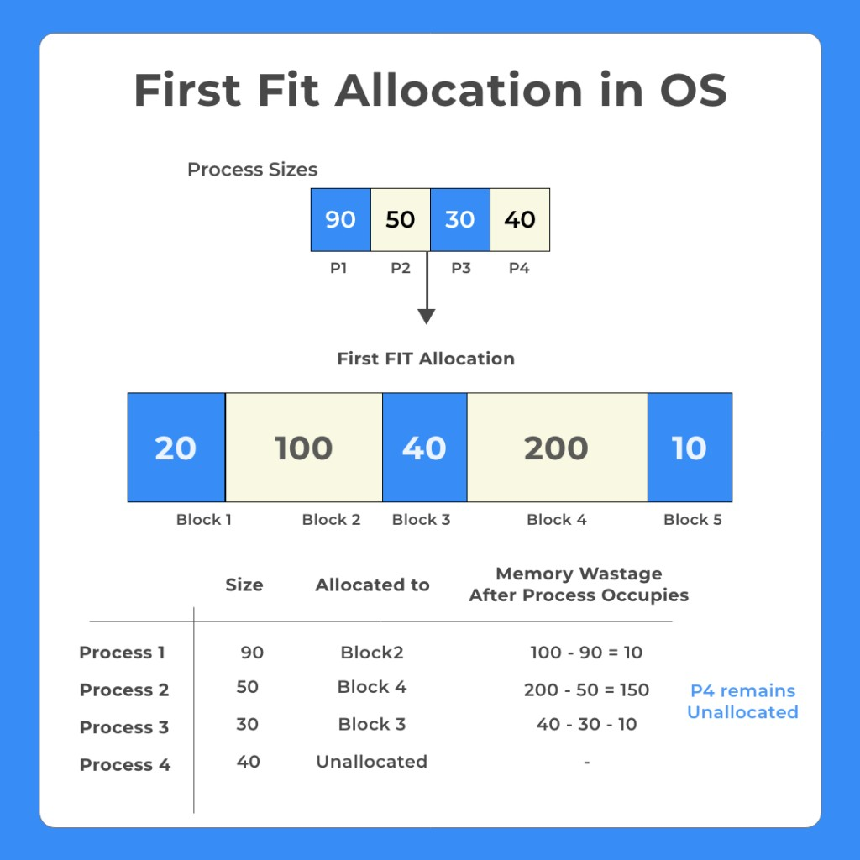

Slide 23
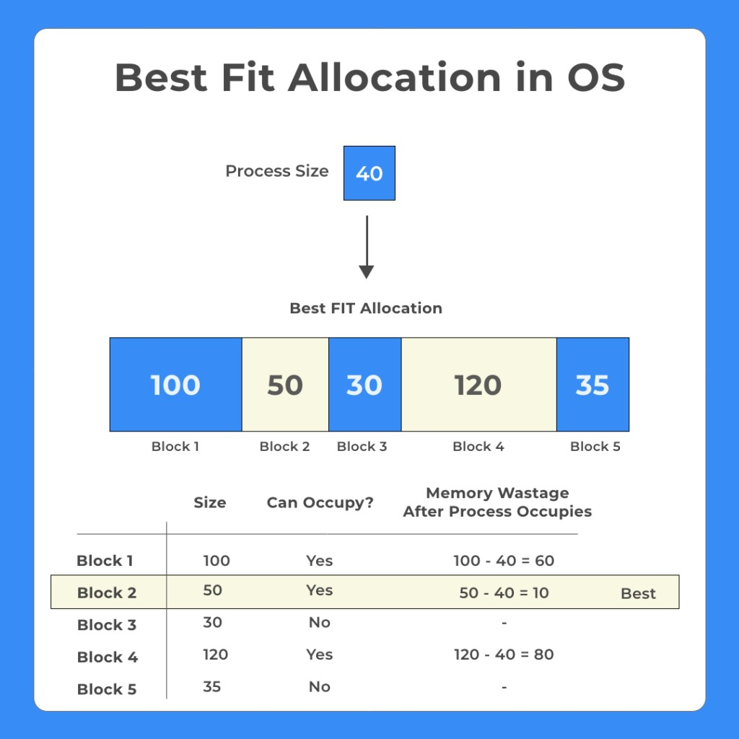

Slide 24
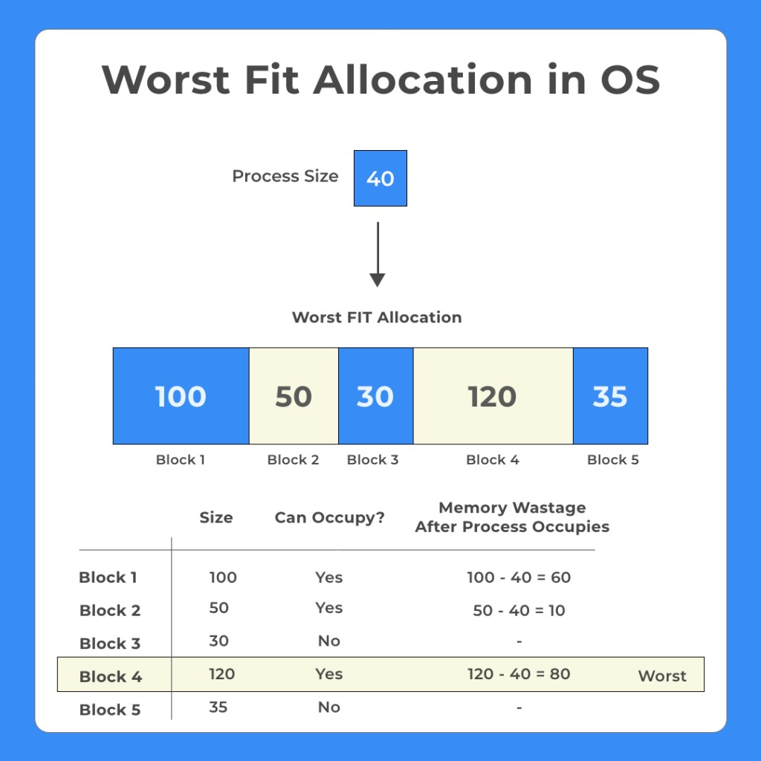

Slide 25
EX1: Given six memory partitions of 300 KB, 600 KB, 350 KB, 200 KB, 750 KB, and 125 KB (in order), how would the First-fit, Best-Fit, and worst-Fit algorithms place processes of size 115 KB, 500 KB, 358 KB, 200 KB, and 375 KB (in order)?
First -Fit:
115 KB is put in 300-KB partition, leaving 185 KB, 600 KB, 350 KB, 200 KB, 750 KB, 125 KB
500 KB is put in 600-KB partition, leaving 185 KB, 100 KB, 350 KB,
200 KB, 750 KB, 125 KB
358 KB is put in 750-KB partition, leaving 185 KB, 100 KB, 350 KB, 200 KB, 392 KB, 125 KB
200 KB is put in 350-KB partition, leaving 185 KB, 100 KB, 150 KB, 200 KB, 392 KB, 125 KB
375 KB is put in 392-KB partition, leaving 185 KB, 100 KB, 150 KB, 200 KB, 17 KB, 125 KB

Slide 26
Best-Fit
a.115 KB is put in 125-KB partition, leaving 300 KB, 600 KB, 350 KB, 200 KB, 750 KB, 10 KB
500 KB is put in 600-KB partition, leaving 300 KB, 100 KB, 350 KB, 200 KB, 750 KB, 10 KB
358 KB is put in 750-KB partition, leaving 300 KB, 100 KB, 350 KB, 200 KB, 392 KB, 10 KB
200 KB is put in 200-KB partition, leaving 300 KB, 100 KB, 350 KB,
0KB, 392 KB, 10 KB
375 KB is put in 392-KB partition, leaving 300 KB, 100 KB, 350 KB, 0KB, 17 KB, 10 KB

Slide 27
Worst Fit:
115 KB is put in 750-KB partition, leaving 300 KB, 600 KB, 350 KB, 200KB, 635 KB, 125 KB
500 KB is put in 635-KB partition, leaving 300 KB, 600 KB, 350 KB, 200 KB, 135 KB, 125 KB
358 KB is put in 600-KB partition, leaving 300 KB, 242 KB, 350 KB, 200 KB, 135 KB, 125 KB
200 KB is put in 350-KB partition, leaving 300 KB, 242 KB, 150 KB,
200 KB, 135 KB, 125 KB
375 KB must wait

Slide 28
Fragmentation
External Fragmentation – total memory space exists to satisfy a request, but it is not contiguous
Internal Fragmentation – allocated memory may be slightly larger than requested memory; this size difference is memory internal to a partition, but not being used
First fit analysis reveals that given N blocks allocated, 0.5 N blocks lost to fragmentation
1/3 may be unusable -> 50-percent rule
Solution to Fragmentation – 1.Compaction 2. Paging
Reduce external fragmentation by compaction
Shuffle memory contents to place all free memory together in one
large block
Compaction is possible only if relocation is dynamic, and is done at execution time

Slide 29
Paging
Physical
address space of a process can be noncontiguous; process
is allocated physical memory whenever the latter is available
Avoids external fragmentation
Avoids problem of varying sized memory chunks
Divide physical memory into fixed-sized blocks called frames
Size is power of 2, between 512 bytes and 16 Mbytes
Divide logical memory into blocks of same size called pages
Keep track of all free frames
To run a program of size N pages, need to find N free frames and
load program
Set up a page table to translate logical to physical addresses
Backing store likewise split into pages
Still have Internal fragmentation

Slide 30
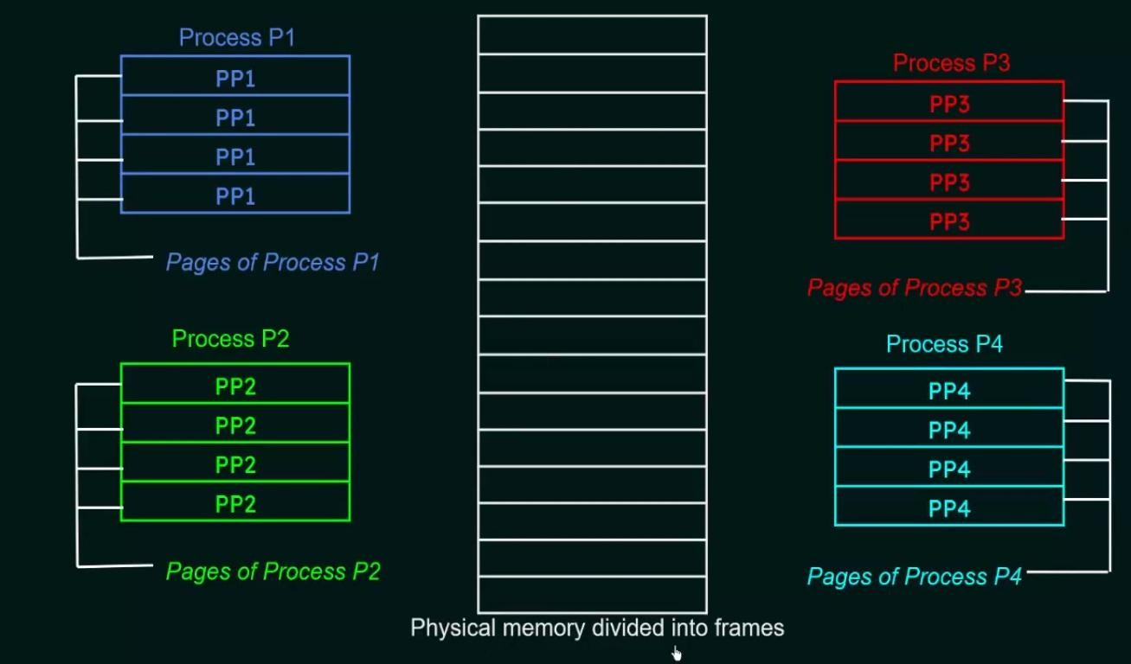

Slide 31
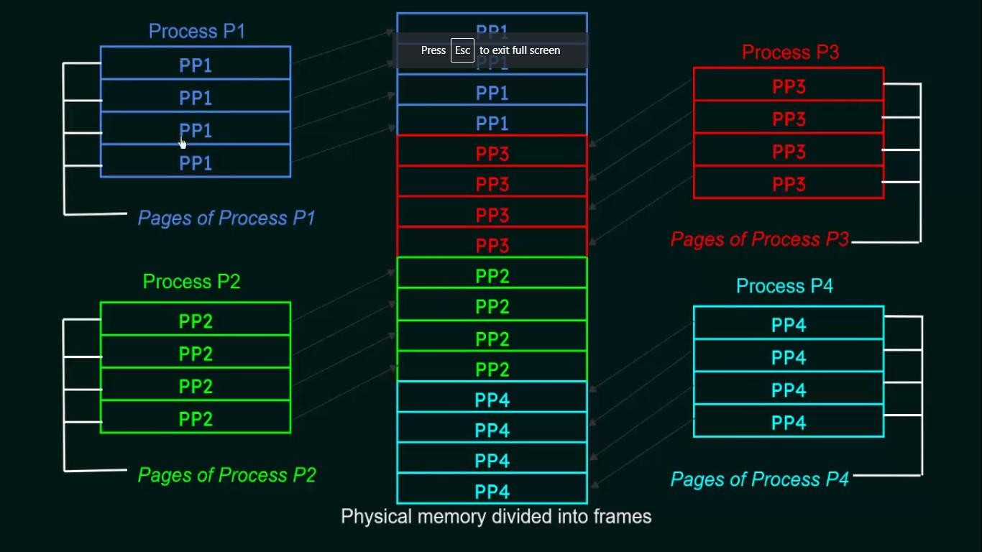

Slide 32
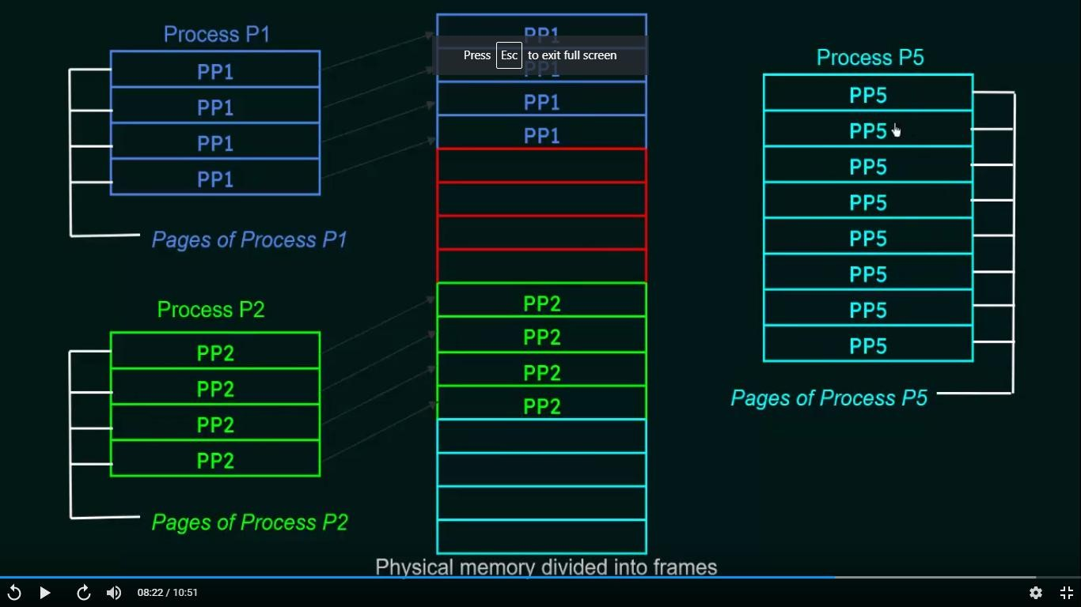

Slide 33
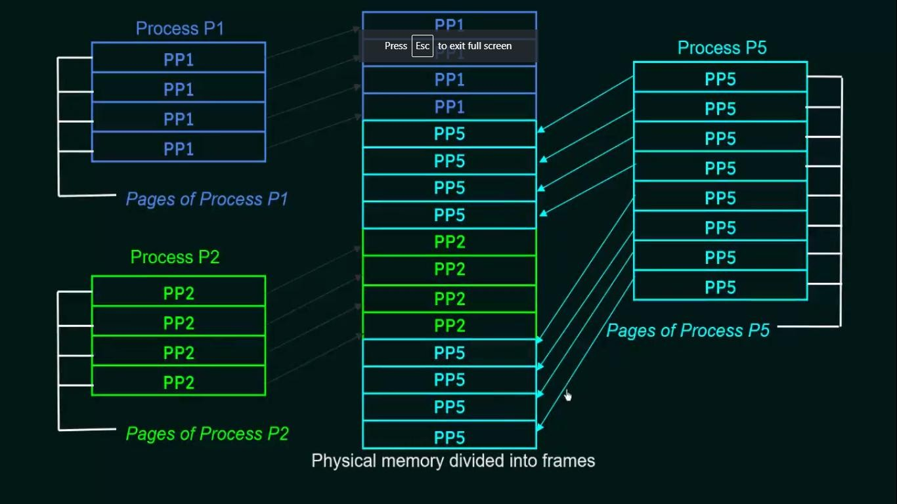

Slide 34
Address Translation Scheme
Address generated by CPU is divided into:
Page number (p) – used as an index into a page table which contains base address of each page in physical memory
Page offset (d) – combined with base address to define the physical memory address that is sent to the memory unit

Slide 35
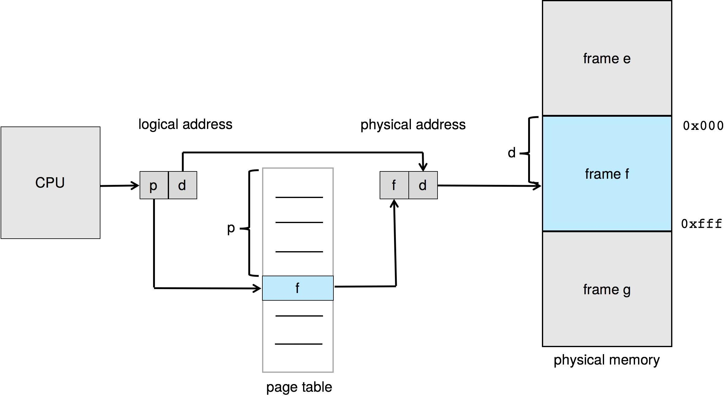
Paging Hardware

Slide 36
The page size is defined by the hardware. The size of a page is a power of 2, typically varying between 4 KB and 1 GB per page, depending on the computer architecture. The selection of a power of 2 as a page size makes the translation of a logical address into a page number and page offset particularly easy.
If the size of the logical address space is 2^{m}, and a page size is 2^{n} bytes, then the high-order m−n bits of a logical address designate the page number, and the n low-order bits designate the page offset. Thus, the logical address is as follows: where p is an index into the page table and d is the displacement within the page.
p a g e n u m b e r | p a g e o ffs e t
p | d
m - n
n
For given logical address space 2^{m} and page size 2^{n}

Slide 37

Paging Model of Logical and Physical Memory
Page number
Frame number
The steps taken by the MMU to translate a logical address to physical address:
Step1. Extract the page number p and use it as an index into the page table.
Step2. Extract the corresponding frame number f
from the page table.
Step3. Replace the page number p in the logical
address with the frame number f .

Slide 38
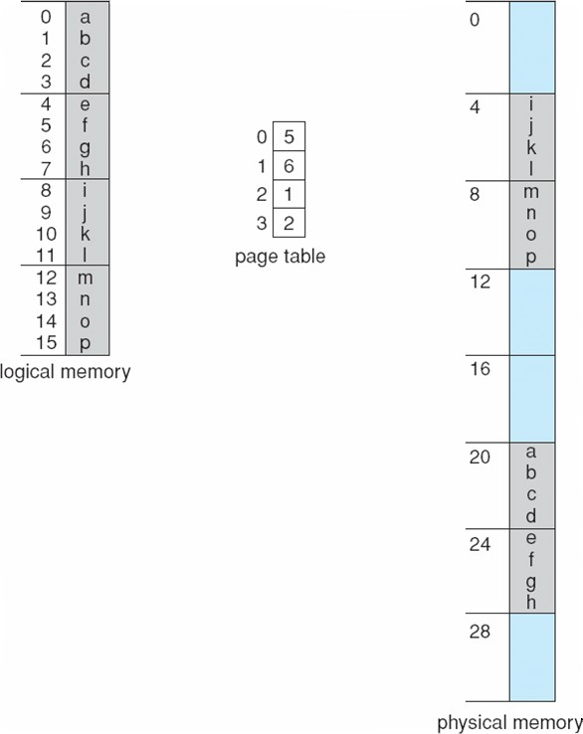
Translation of Logical address into Physical address using Page Table
Logical address: n = 2(page size of 4 bytes ) and m = 4(16 addresses).
Using a page size of 4 bytes and a physical memory of 32 bytes (8 pages)
Page 0
Frame 0
Page 1
Frame 1
Page 2
Frame 2
Page 3
Frame 3
Frame 4
Frame 5
Frame 6
Frame 7

Slide 39
The programmer‘s view of memory can be mapped into physical
memory as, Logical address 0 is page 0, offset 0.
Logical address into Physical address is calculated as ,
Physical address= [ ( frame × page size)+ Offset]
Indexing into the page table, find that page 0 is in frame 5. So, logical address 0 maps to physical address 20 [= (5 × 4) +0].
Logical address 3 (page 0, offset 3) maps to physical address 23 [=
(5 × 4) + 3].
Logical address 4 is page 1, offset 0; according to the page table, page 1 is mapped to frame 6. Thus, logical address 4 maps to physical address 24 [= (6× 4) + 0].

Slide 40
Paging -- Calculating internal fragmentation
Page size = 2,048 bytes ; suppose Process size = 72,766 bytes
35 pages + 1,086 bytes
Internal fragmentation of 2,048 - 1,086 = 962 bytes
In the worst case, a process would need n pages plus 1 byte.
It would be allocated n + 1 frames, resulting in internal fragmentation of almost an entire frame.
But each page table entry takes memory to track
If process size is independent of page size, expect internal fragmentation to average one-half page per process. This consideration suggests that small page sizes are desirable. However, overhead is involved in each page table entry, and this overhead is reduced as the size of the pages increases.
Page sizes growing over time; Solaris supports two page sizes – 8 KB and 4 MB- larger page size called huge pages.

Slide 41
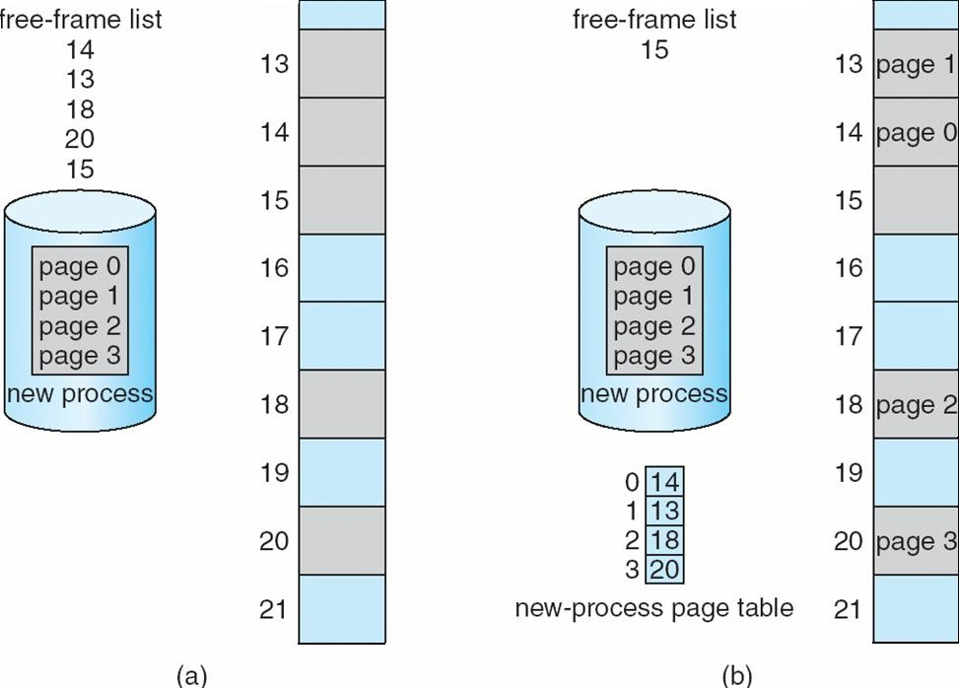
Free Frames
Before allocation
After allocation

Slide 42
When a process arrives in the system to be executed, its size, expressed
in pages, is examined.
Each page of the process needs one frame. Thus, if the process requires
n pages, at least n frames must be available in memory.
If n frames are available, they are allocated to this arriving process.
The first page of the process is loaded into one of the allocated frames,
and the frame number is put in the page table for this process.
The next page is loaded into another frame, its frame number is put
into the page table, and so on.
The operating system is managing physical memory, it must be aware of the allocation details of physical memory—which frames are allocated, which frames are available, how many total frames there are, and so on.
This information is generally kept in a single, system-wide data structure called a frame table. The frame table has one entry for each physical page frame, indicating whether the latter is free or allocated and, if it is allocated, to which page of which process (or processes).

Slide 43
Hardware Support
Page tables are per-process data structures, a pointer to the page table is stored in the register (like the instruction pointer) in the process control block of each process.
When the CPU scheduler selects a process for execution, it must reload the user registers and the appropriate hardware page-table values from the stored user page table.

Slide 44
Implementation of Page Table
Method 1: The page table is implemented as a set of dedicated high-speed hardware registers, which makes the page-address translation very efficient.
Drawback: The use of registers for the page table is satisfactory if the page table is reasonably small (for example, 256 entries). Most contemporary CPUs, support much larger page tables (for example, 2²⁰ entries). For these machines, the use of fast registers to implement the page table is not feasible.
Method 2 : keep the Page table in main memory, Page-table base register (PTBR) points to the page table and Page-table length register (PTLR) indicates size of the page table
Drawback: In this scheme every data/instruction access requires two memory accesses - One for the page table and one for the data / instruction
Method 3 : The two-memory access problem can be solved by the use of a special fast-lookup hardware cache called translation look-aside buffers (TLBs) (also called associative memory).

Slide 45
Translation Look-Aside Buffer
TLB is associative, high speed memory
It consists of two parts- Key and value
Some TLBs store address-space identifiers (ASIDs) in each TLB
entry – uniquely identifies each process
When the associative memory is presented with an item, the item is
compared with all keys simultaneously
If the item is found, the corresponding value field is returned and the search is fast
TLBs typically small (64 to 1,024 entries)
When a logical address is generated by the CPU, its page number is
presented to the TLB
If the page number is found, its frame number is immediately available and is used to access memory → TLB Hit

Slide 46
Translation Look-Aside Buffer(Continued)
If the page number is not in the TLB → TLB Miss ; A memory reference to the page table must be made. When the frame number is obtained, use it to access memory. Add the page and frame number to TLB, so that it will be found quickly on the next reference.
Replacement policies must be considered
Some entries can be wired down for permanent fast access
Address translation (p, d)
If p is in associative register, get frame # out
Otherwise get frame # from page table in memory
P a g e # | F r a m e #

Slide 47

Paging Hardware With TLB

Slide 48
Effective Access Time
Hit ratio – percentage of times that a page number is found in the TLB
An 80% hit ratio means that , the desired page number in the TLB is 80% of the time.
Suppose that 10 nanoseconds to access memory.
If the desired page in TLB then a mapped-memory access take 10 ns
Otherwise , need two memory access so it is 20 ns
Effective Access Time (EAT)
EAT = 0.80 x 10 + 0.20 x 20 = 12 ns
in access time
Consider amore realistic hit ratio of 99%,
implying 20% slowdown
EAT = 0.99 x 10 + 0.01 x 20 = 10.1ns implying slowdown in access time.
only 1%

Slide 49
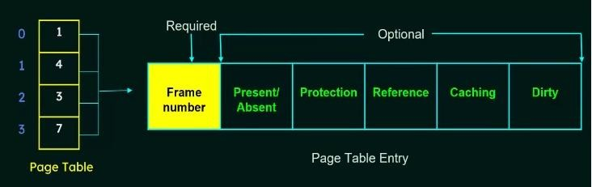
Page Table Entry
Page table entries contains several information about pages which vary from OS to OS
The most important information in a page table entry is the frame number.
The remaining information are optional

Slide 50
Frame number denotes the frame where the page is present in the main memory. The number of bits required for this depends on the number of frames in the main memory
Memory Protection
Present/Absent bit specifies whether the page is present in the main memory or not. It is also called Valid/Invalid bit.
If the page we are looking for is not present in main memory , it is called PAGE FAULT. Also the present/Absent bit is set to ‗0‘).
The protection bit known as Read/Write bit is used for page protection.
It specifies the permissions for read or write operations on the page
The bit is set to ‗0‘ if only read operation is allowed and set to ‗1‘ if both read and write operations are allowed
The Reference bit specifies whether the page has been referenced
in the last clock cycle or not.
It is set to ‗1‘ when the page is accessed

Slide 51
The caching bit is used for enabling or disabling caching of the
page.
When always fresh data is needed disable caching so as to avoid
fetching of old data from the cache
When caching has to be disabled , this bit is set to‘1‘. Otherwise it is set to ‗0‘.
Dirty bit is also known as Modified bit. It specifies whether the page has been modified or not.
If the page has been modified, the this bit is set to ‗1‘ , otherwise it is
‗0‘
This bit helps in avoiding unnecessary writes to the secondary
memory when a page is replaced by another page.

Slide 52
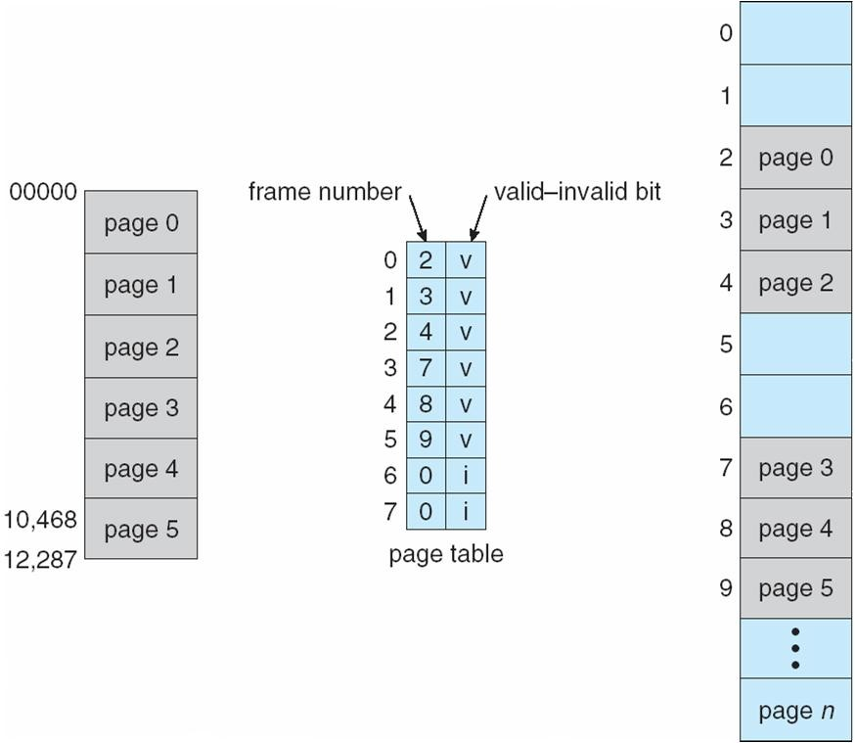
Valid (v) or Invalid (i) Bit In A Page Table

Slide 53
Shared Pages
Shared code
One copy of read-only (reentrant code or pure code) shared among processes (i.e., text editors, compilers, window systems)
Reentrant code is non self modifying code. It never changes during execution
Thus, two or more processes can execute the same code at the
same time.
Also useful for interprocess communication if sharing of read- write pages is allowed
Private code and data
Each process keeps a separate copy of the code and data
The pages for the private code and data can appear anywhere in
the logical address space

Slide 54
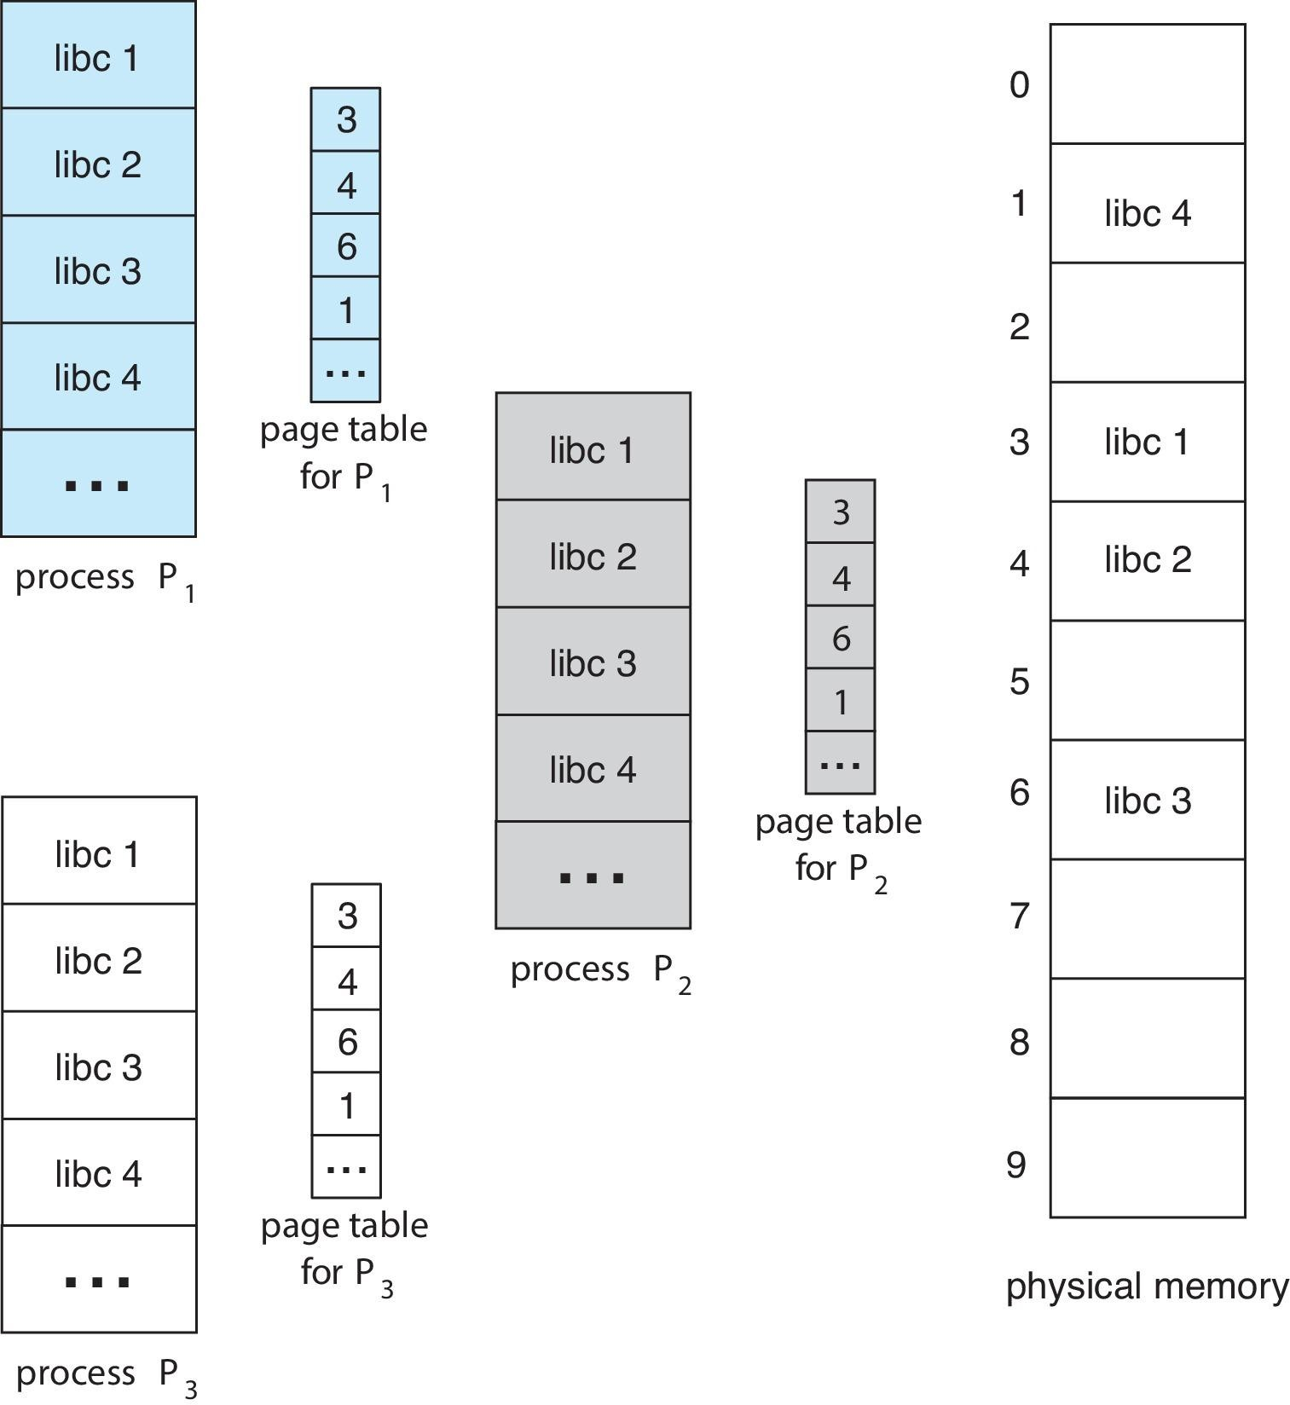
Shared Pages Example

Slide 55
Advantage of using shared Pages
Only one copy of the standard C library need be kept in physical memory, and the page table for each user process maps onto the same physical copy of libc.
Thus, to support 40 processes, it need only one copy of the library, and the total space now required is 2 MB instead of 80 MB—a significant saving in physical memory
In addition to run-time libraries such as libc, other heavily used programs can also be shared—compilers, window systems, database systems

Slide 56
Structure of the Page Table
Memory structures for paging can get huge.
Consider a 32-bit logical address space as on modern computers
Page size of 4 KB (2¹²)
Page table would have 1 million entries (2³² / 2¹²) = 2²⁰ = 1MB
If each entry is 4 bytes ➔ each process 4 MB of physical address
space for the page table alone
Don’t want to allocate that contiguously in main memory
One simple solution is to divide the page table into smaller units.
This division is done in 3 ways
Hierarchical Paging
Hashed Page Tables
Inverted Page Tables

Slide 57

Hierarchical Page Tables
Break up the logical address space into multiple page tables
A simple technique is a two-level page table
page the page table

Slide 58
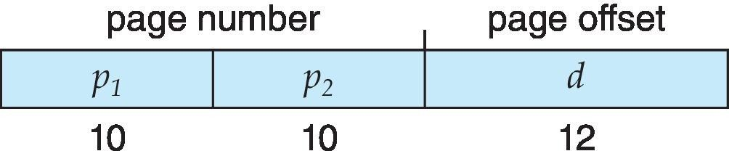
Two-Level Paging Example
A logical address (on 32-bit machine with 4K page size) is divided into:
a page number consisting of 20 bits
a page offset consisting of 12 bits
Since the page table is paged, the page number is further divided into:
a 10-bit page number
a 10-bit page offset
Thus, a logical address is as follows:
where p₁ is an index into the outer page table, and p₂ is the displacement within the page of the inner page table
Known as forward-mapped page table

Slide 59

Address-Translation Scheme

Slide 60
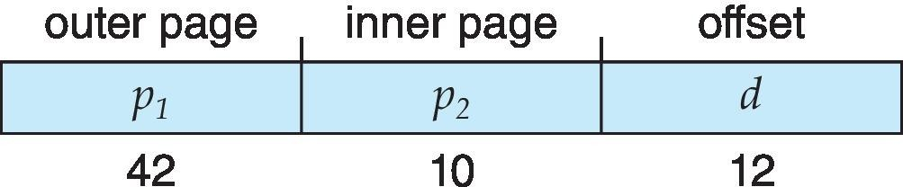
64-bit Logical Address Space
Even two-level paging scheme not sufficient
If page size is 4 KB (2¹²)
Then page table has 2⁵² entries
If two level scheme, inner page tables could be 2¹⁰ of 4byte entries
Address would look like
Outer page table has 2⁴² entries – Large in size; One solution is to add a 2nd outer page table
And possibly 4 memory access to get to one physical memory location

Slide 61
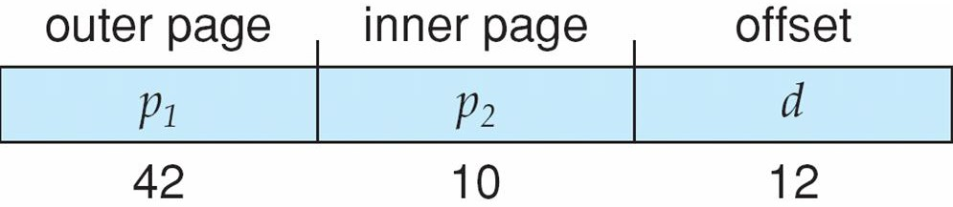
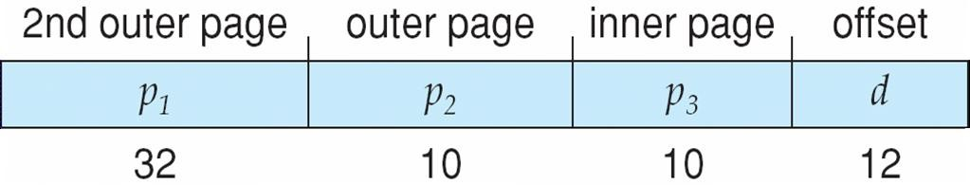
Three-level Paging Scheme

Slide 62
Hashed Page Tables
Common in address spaces > 32 bits
The virtual page number is hashed into a page table
This page table contains a chain of elements hashing to the same location
Each element contains (1) the virtual page number (2) the value of
the mapped page frame (3) a pointer to the next element
The algorithm works as follows: The virtual page number in the virtual address is hashed into the hash table. The virtual page number is compared with field 1 in the first element in the linked list. If there is a match, the corresponding page frame (field 2) is used to form the desired physical address. If there is no match, subsequent entries in the linked list are searched for a matching virtual page number.
Variation for 64-bit addresses is clustered page tables
Similar to hashed but each entry refers to several pages (such as
16) rather than 1 Especially useful for sparse address spaces
(where memory references are non-contiguous and scattered)

Slide 63

Hashed Page Table

Slide 64
Inverted Page Table
In most operating system, a separate page table is maintained for
each process
So, for ‗n‘ number of processes, there will be ‗n‘ number of page tables.
For large processes, there would be many pages and for maintaining information about these pages, there would be too many entries in their page tables which itself would occupy a lot of the memory
Hence memory utilization is not efficient as a lot of memory is wasted in maintaining page tables itself
Solution to memory utilization is Inverted page tables.

Slide 65
Inverted Page Table(continued)
An inverted page table has one entry for each real page(or frame) of memory
Each entry consists of the virtual address of the page stored in that real memory location, with information about the process that owns that page
Thus, only one page table is in the system, and it has only one entry
foe each page of physical memory
Each virtual address consists of a triple fields
Each inverted Page table entry is a pair of fields
Process-id | Page number | Offset
Process-id | Page number

Slide 66

Inverted Page Table Architecture
Indexed by frame number

Slide 67
Working:
When a memory reference occurs,
part of the virtual address, is presented to the memory
consisting of <process-id, pagenumber>,
subsystem.
The inverted page table is then searched for a match.
If a match is found—say, at entry i—then the physical address <i, offset> is generated.
If no match is found, then an illegal address access has been attempted.
Advantage : Reduces memory usage
Disadvantages: 1. Increased search time as inverted page table is sorted by physical address, but lookups on virtual addresses. The entire table need to be searched for a match.
2. Difficulty in implementing shared memory
Solutions : 1. Use hash table to limit the search to one — or at most a few — page-table entries 2.TLB can accelerate access
Solution to implement shared memory is One mapping of a virtual address to the shared physical address

Slide 68
Swapping
A process must be in memory to be executed.
A process can be swapped temporarily out of memory to a backing store, and then brought back into memory for continued execution
Total physical memory space of processes can exceed physical memory
[ex]: Round robin CPU scheduling algorithm- When a quantum expires , the memory manager will start to swap out the process and to swap another process into the memory space that has been freed.
Backing store – fast disk large enough to accommodate copies of all memory images for all users; must provide direct access to these memory images
Roll out, roll in – swapping variant used for priority-based scheduling algorithms; lower-priority process is swapped out so higher-priority process can be loaded and executed

Slide 69
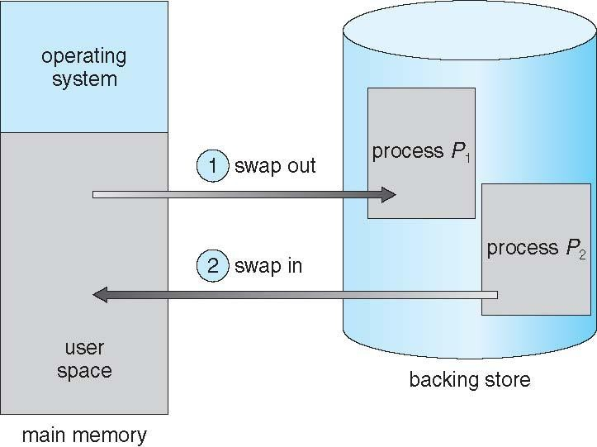
Schematic View of Swapping

Slide 70
Swapping (Cont.)
Major part of swap time is transfer time; total transfer time is directly
proportional to the amount of memory swapped
System maintains a ready queue of ready-to-run processes which
have memory images on disk
Does the swapped out process need to swap back in to same physical addresses? – Normally a process that is swapped out will be swapped back into the same memory space it occupied previously; But it depends on address binding method
If binding is done at assembly or load time : The process is in same memory location;
If binding is done at execution time: The process is swapped into
a different memory space

Slide 71
Modified versions of swapping are found on many systems (i.e., UNIX, Linux, and Windows)
Swapping normally disabled
Started if more than threshold amount of memory allocated
Disabled again once memory demand reduced below threshold
Context Switch Time including Swapping
If next processes to be put on CPU is not in memory, need to swap out a process and swap in target process
Context switch time can then be very high
10MB process swapping to hard disk with transfer rate of 40MB/sec
Swap out time = process size/ Transfer rate = 10MB/40MB = 250 ms
For both swap out and swap in , the total swap time(context switch ing time) is = 250*2 = 500ms
Plus swap in of same sized process
Can reduce if reduce size of memory swapped – by knowing how much memory really being used- System calls to inform OS of memory use via request_memory() and release_memory()

Slide 72
Context Switch Time and Swapping (Cont.)
Other constraints as well on swapping
Pending I/O – can‘t swap out as I/O would occur to wrong
process
Or always transfer I/O to kernel space, then to I/O device
Known as double buffering, adds overhead
Standard swapping not used in modern operating systems
But modified version common
Swap only when free memory extremely low

Slide 73
Swapping on Mobile Systems
Not typically supported
Flash memory based
Small amount of space
Limited number of write cycles
Poor throughput between flash memory and CPU on mobile platform
Instead use other methods to free memory if low
iOS asks apps to voluntarily relinquish allocated memory
Read-only data thrown out and reloaded from flash if needed
Failure to free can result in termination
Android terminates apps if low free memory, but first writes
application state to flash for fast restart
Both OSes support paging

Slide 74
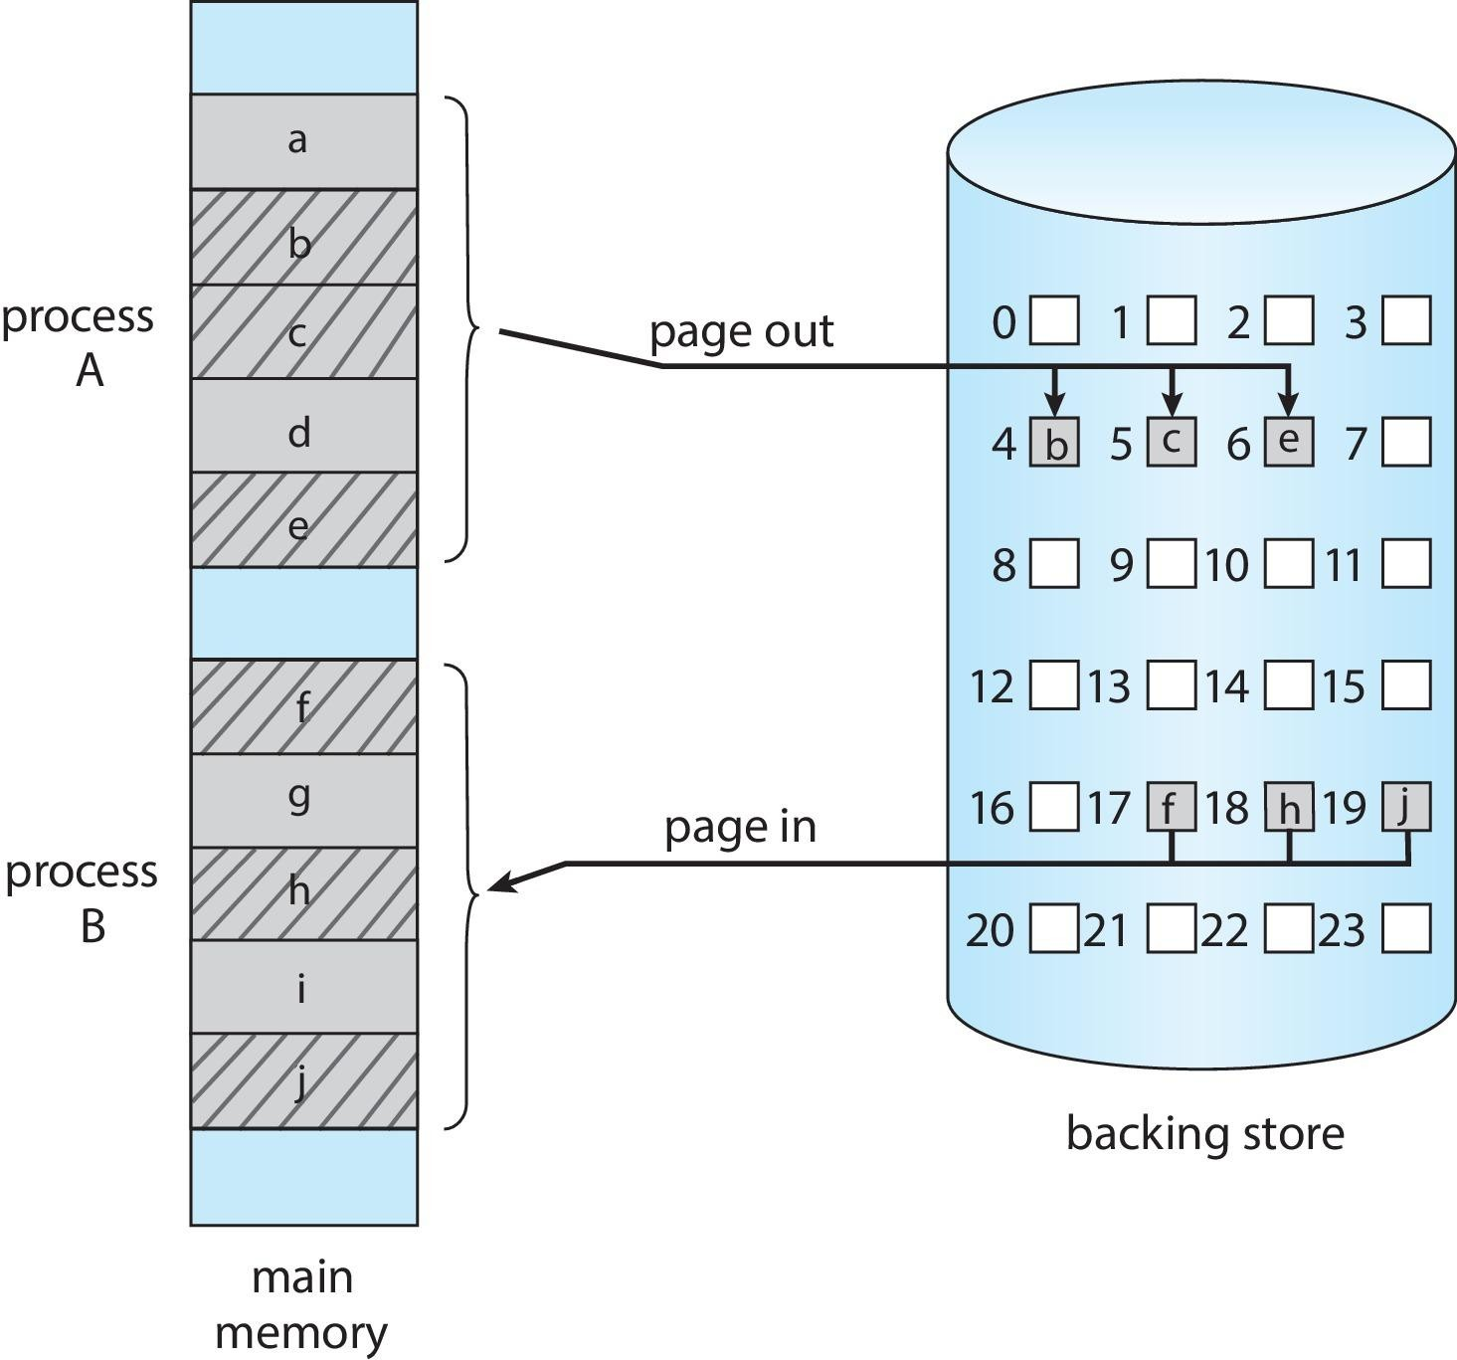
Swapping with Paging

Slide 75
Segmentation
Memory-management scheme that supports user view of memory
Segmentation is another non-contiguous memory allocation like paging
Unlike paging, in segmentation , the processes are not divided into
fixed size pages
Instead , the processes are divided into several modules called segments
A segment is a logical unit such as:
main program, procedure, function, method, object, local variables, global variables, common block, stack, symbol table, arrays etc
So, both secondary memory and main memory are divided into partitions of unequal sizes

Slide 76
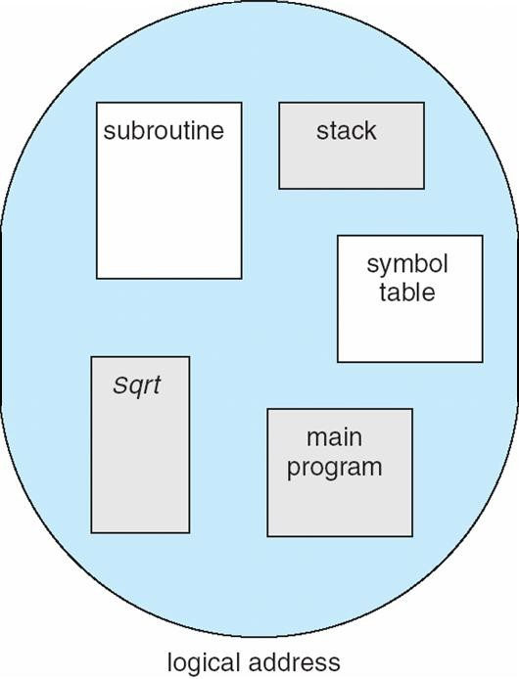
User’s View of a Program
segment1
segment2
segment3
segment4
segment5

Slide 77
Logical View of Segmentation
1
4
2
3
1
2
3
4
user space
physical memory space

Slide 78
Segmentation Architecture
Logical address is a collection of segments
Logical address consists of a two tuple:
<segment-number, offset>,
Segment table – maps two-dimensional user defined addresses into one dimensional physical addresses;
each table entry has:
base – contains the starting physical address where the segments reside in memory
limit – specifies the length of the segment
Segment-table base register (STBR) points to the segment table’s location in memory
Segment-table length register (STLR) indicates number of
segments used by a program;
segment number s is legal if s < STLR

Slide 79
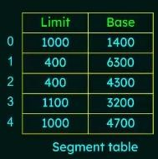
Logical address consists of segment number ‗s‘ and an offset into that
segment ‗d‘.
The segment number is used as an index to the segment table.
The offset ‗d‘ of the logical address between 0 and the limit.
When an offset is legal, it is added to the segment base to produce the address in physical memory
When an offset is beyond the limit, trap to the operating system

Slide 80
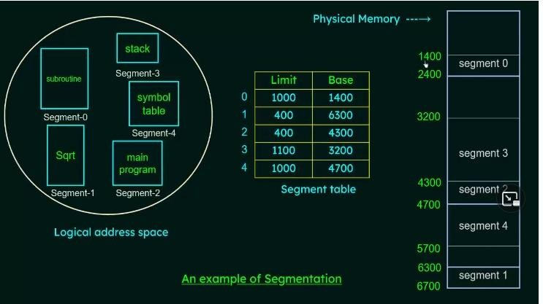

Slide 81
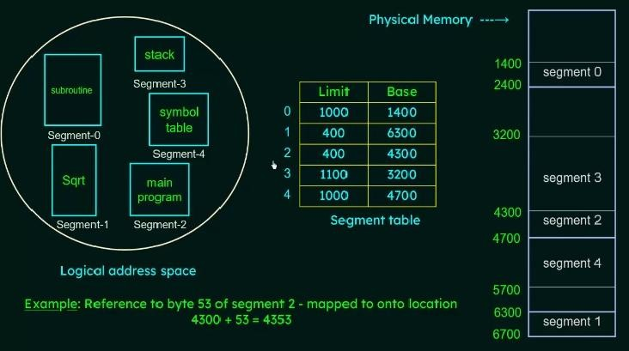

Slide 82
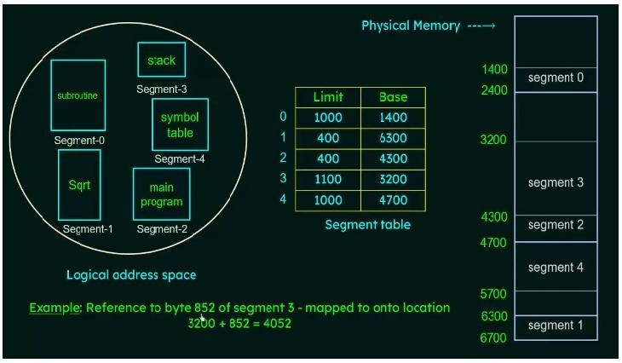

Slide 83
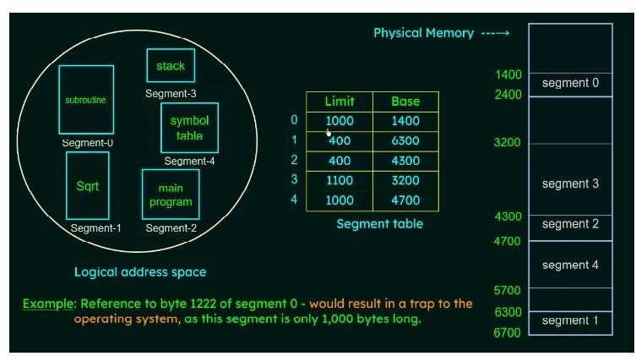

Slide 84
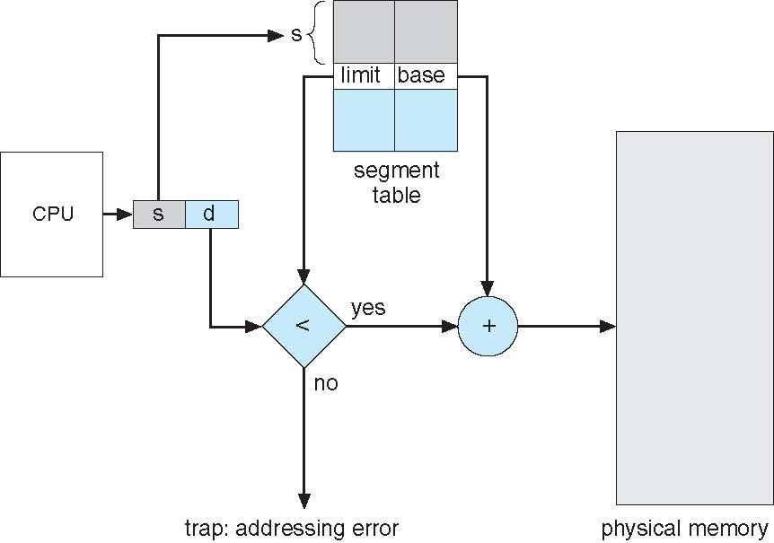
Segmentation Hardware

Slide 85
Segmentation Architecture (Cont.)
Protection
With each entry in segment table associate:
validation bit = 0 ⇒ illegal segment
read/write privileges
Protection bits associated with segments
Since segments vary in length, memory allocation is a dynamic storage-allocation problem

Slide 86
Virtual Memory - Background
Code needs to be in memory to execute, but entire program rarely used. [ex]
Programs often have code to handle unusual error conditions. Since these errors seldom, in practice, this code is almost never executed.
Arrays, lists, and tables are often allocated more memory than they actually need. An array may be declared 100 by 100 elements, even though it is seldom larger than 10 by 10 elements.
Certain options and features of a program may be used rarely. For instance, the routines on U.S. Government computers that balance the budget have not been used in many years.
Symbol table have 3000 symbols , but the average program has less than 200 symbols
Entire program code not needed at same time

Slide 87
The ability to execute a program that is only partially in memory would
confer many benefits:
A program would no longer be constrained by the amount of physical memory that is available. Users would be able to write programs for an extremely large virtual address space, simplifying the programming task.
Because each program could take less physical memory, more programs could be run at the same time, with a corresponding increase in CPU utilization and throughput but with no increase in response time or turnaround time.
Less I/O would be needed to load or swap portions of programs into memory, so each program would run faster.
So, running a program that is not entirely in memory would benefit both the system and its users.

Slide 88
Virtual memory
Virtual memory – separation of user logical memory from physical memory
Only part of the program needs to be in memory for execution
Logical address space can therefore be much larger than physical address
space
Allows address spaces to be shared by several processes
Allows for more efficient process creation
More programs running concurrently
Less I/O needed to load or swap processes
Virtual address space – logical view of how process is stored in memory
Usually start at address 0, contiguous addresses until end of space
Meanwhile, physical memory organized in page frames
MMU must map logical to physical
Virtual memory can be implemented via:
Demand paging
Demand segmentation

Slide 89
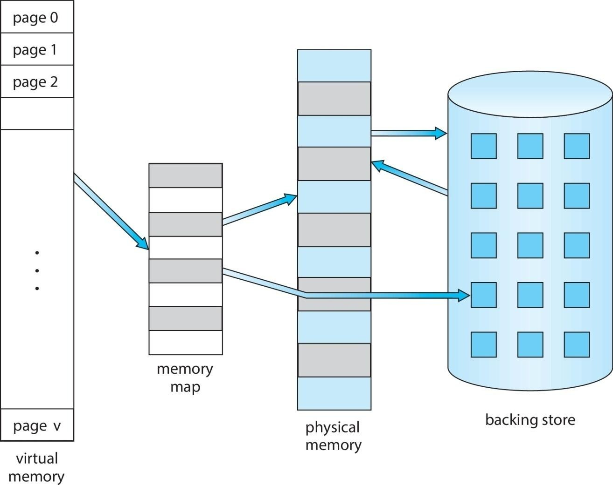
Virtual Memory That is Larger Than Physical Memory

Slide 90
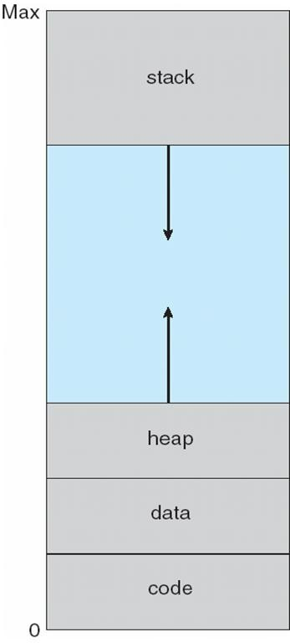
Virtual-address Space
Usually design logical address space for stack to start at Max logical address and grow ―down‖ while heap grows ―up‖
Maximizes address space use
The large blank space (or hole) between the heap and the stack is part of the virtual address space.
Enables sparse address spaces with holes left for growth, dynamically linked libraries, etc. System libraries shared via mapping into virtual address space
Shared memory by mapping pages read- write into virtual address space

Slide 91
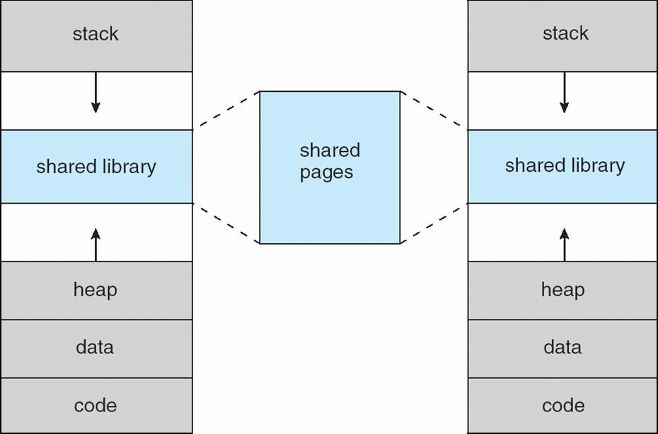
Shared Library Using Virtual Memory

Slide 92
Demand Paging
Load pages into memory only when it is needed. Pages that are never accessed are never loaded into physical memory. This is called demand paging.
Advantages of Demand paging:
Less I/O needed, no unnecessary I/O
Less memory needed
Faster response
More users
Similar to paging system with swapping; Rather than swapping the entire process into memory, use a lazy swapper.
Lazy swapper – never swaps a page into memory unless page will be needed
Swapper that deals with pages is a pager

Slide 93
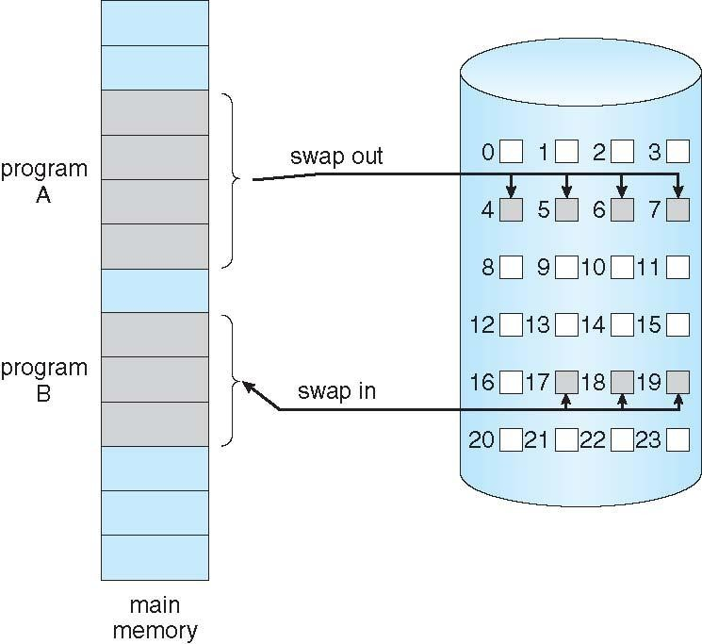
Demand Paging

Slide 94
Basic Concepts
With swapping, pager guesses which pages will be used before swapping out again; Instead, pager brings in only those pages into memory
How to determine that set of pages?
Need new MMU functionality to implement demand paging
If pages needed are already memory resident
No difference from non demand-paging
If page needed and not memory resident
Need to detect and load the page into memory from storage
Without changing program behavior
Without programmer needing to change code

Slide 95
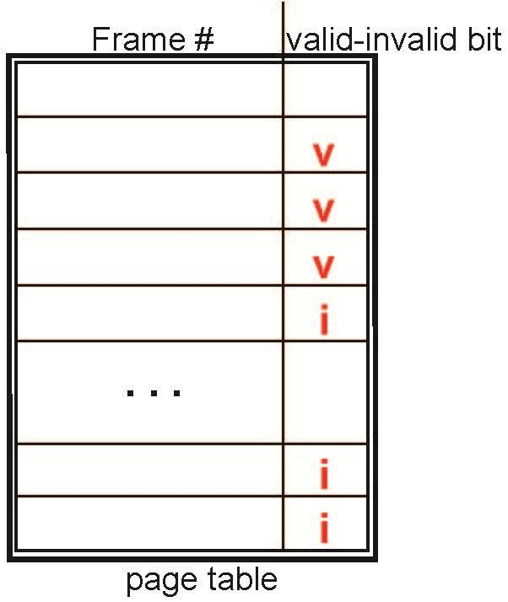
Valid-Invalid Bit
With each page table entry a valid–invalid bit is associated (v ⇒ in-memory – memory resident, i ⇒ not-in-memory)
Initially valid–invalid bit is set to i on all entries
Example of a page table snapshot:
During MMU address translation, if valid–invalid bit in page table
entry is i ⇒ page fault

Slide 96
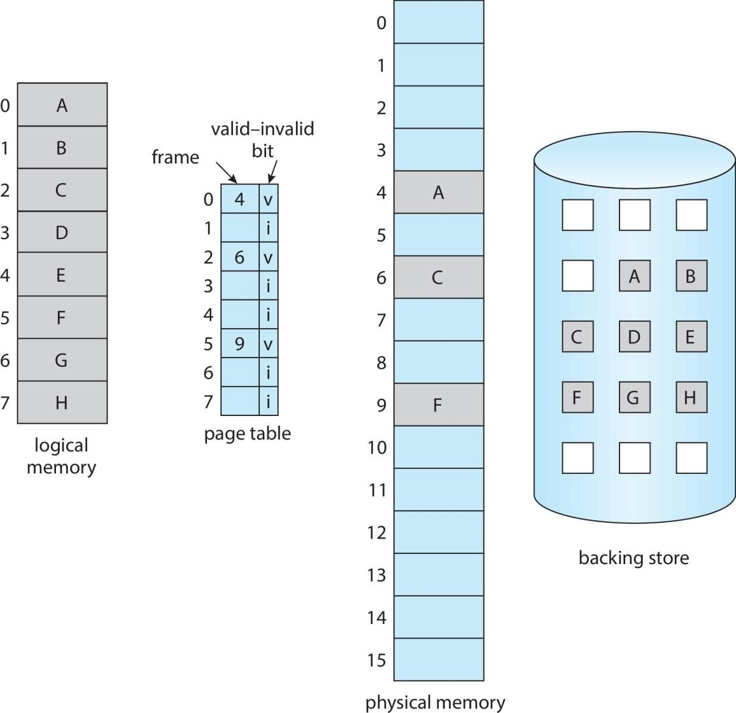
Page Table When Some Pages Are Not in Main Memory

Slide 97
Aspects of Demand Paging
Access a page that is not present in memory is known as Page fault
and it causes page fault trap to operating system
Page fault may occur at any memory reference:
If the page fault occurs on the instruction fetch, restart by fetching the instruction again
If the page fault occurs while fetching an operand, fetch and decode
the instruction again and then fetch the operand.
Consider a three-address instruction such as ADD the content of A to B, placing the result in C. These are the steps to execute this instruction:
Fetch and decode the instruction (ADD).
Fetch A.
Fetch B.
Add A and B.
Store the sum in C.

Slide 98
Page fault occurs when try to store in C (because C is in a page not currently in memory). So, to get the desired page, bring it in, correct the page table, and restart the instruction.
The restart will require
fetching the instruction again
decoding it again
fetching the two operands again, and
then adding again
Store the sum in C

Slide 99
Steps in Handling Page Fault
If there is a reference to a page, first reference to that page will trap to operating system
Page fault
Operating system looks at PCB(Process Control Block) table to decide:
Invalid reference ⇒ abort
Just not in memory ⇒ bring into memory
Find free frame
Swap page into frame via scheduled disk operation
Reset tables to indicate page now Set validation bit = v
Restart the instruction that caused the page fault
in memory

Slide 100

Steps in Handling a Page Fault (Cont.)

Slide 101
Free-Frame List
When a page fault occurs, the operating system must bring the desired page from secondary storage into main memory.
Most operating systems maintain a free-frame list -- a pool of free frames for satisfying such requests.
Operating system typically allocate free frames using a technique known as zero-fill-on-demand -- the content of the frames zeroed- out before being allocated.
When a system starts up, all available memory is placed on the free- frame list.

Slide 102
Performance of Demand Paging
A computer system performance is affected by Demand paging
Memory Access Time (ma) ranges from 10 to 200ns
If there are no page faults, the Effective Access Time will be equal to
the Memory Access Time
If page fault occurs, Let ‗p‘ be the probability of Page Fault 0 ≤ p ≤ 1
if p = 0 no page faults
if p = 1, every reference is a fault
Effective Access Time (EAT)
EAT = (1 – p) x memory access time + p x page fault time
Time spent for handling
page fault
Time spent for normal memory access

Slide 103
Stages in Demand Paging – Worse Case
1. Trap to the operating system
Save the user registers and process state
Determine that the interrupt was a page fault
Check that the page reference was legal and determine the location of the page
on the disk
Issue a read from the disk to a free frame:
Wait in a queue for this device until the read request is serviced
Wait for the device seek and/or latency time
Begin the transfer of the page to a free frame
While waiting, allocate the CPU to some other user
Receive an interrupt from the disk I/O subsystem (I/O completed)
Save the registers and process state for the other user(If step 6 is executed)
Determine that the interrupt was from the disk
Correct the page table and other tables to show page is now in memory
Wait for the CPU to be allocated to this process again
Restore the user registers, process state, and new page table, and then
resume the interrupted instruction

Slide 104
Not all the steps are necessary in every case. But in all cases the three
major activities for page fault
Service the page fault interrupt - may take 1 to 100µs
Read the page – lots of time – can take 8ms
Restart the process - may take 1 to 100µs
So, an average page fault handling time of 8ms and memory access
time of 200ns.
EAT = (1 – p) x memory access time + p x page fault time
= (1-p) x 200ns + p x 8ms
= 200ns – 200p(ns) + 8000000p(ns) = 200ns + 7999800p(ns)
The effective access time is directly proportional to page fault time. If one access out of 1,000 causes a page fault, then
Effective access time = 200ns + (7999800 x 1/1000) ns = 199.8ns=8.2µs This is a slowdown by a factor of 40 percent
If want performance degradation < 10 percent
One page fault in every 400,000 memory accesses

Slide 105
Copy-on-Write
Copy-on-Write (COW) is a technique that allows both parent and child processes sharing virtual memory or pages. Fork() will create a copy of the parent‘s address space for the child , duplicating the pages belonging to the parent.
Instead of creating duplicate pages, COW make the parent and child to share the common pages and if either process modifies a shared page, only that page is copied
In general, free pages are allocated from a pool of zero-fill-on- demand pages
Pool should always have free frames for fast demand page execution
vfork() variation on fork() system call has parent suspend and child
using copy-on-write address space of parent
Designed to have child call exec()
Very efficient

Slide 106
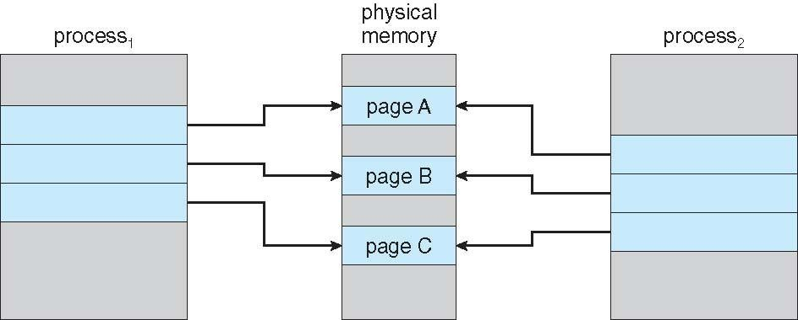
Before Process 1 Modifies Page C

Slide 107
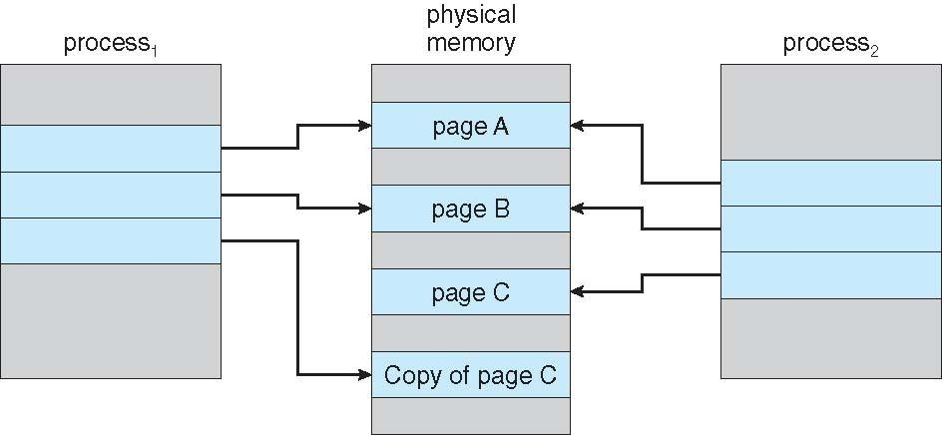
After Process 1 Modifies Page C

Slide 108
Copy-on-write is a common technique used by several operating
systems, including Windows, Linux, and macOS.
Several versions of UNIX (including Linux, macOS, and BSD UNIX) provide a variation of the fork() system call—vfork() (for virtual memory fork)— that operates differently from fork() with copy-on- write. With vfork(), the parent process is suspended, and the child process uses the address space of the parent. Because vfork() does not use copy-on-write, if the child process changes any pages of the parent‘s address space, the altered pages will be visible to the parent once it resumes.
Therefore, vfork() must be used with caution to ensure that the child process does not modify the address space of the parent. vfork() is intended to be used when the child process calls exec() immediately after creation. Because no copying of pages takes place, vfork() is an extremely efficient method of process creation.

Slide 109
Problems of Demand paging
By using demand paging, increasing degree of multiprogramming by loading only the required pages into memory; so, that more processes are loaded into memory. This lead to over allocation of memory.
[Eg]: Suppose 40 frames in memory , 6 processes each of which has 10 pages but uses only 5 at the moment. Load these (6*5) = 30 pages into the memory. So, all the processes are executing simultaneously and still have 10 frames free.
Now, all the 6 processes wants to use all their 10 pages; So, to load the
remaining (6*5) = 30 pages into the memory, but frames.
What can the OS do at this point?
only 10 free
It could terminate the user process- Not the best choice as it destroys
the purpose of demand paging
The OS could instead swap out a process, freeing all its frames and reducing the level of multiprocessing
Use Page replacement technique – most common solution

Slide 110
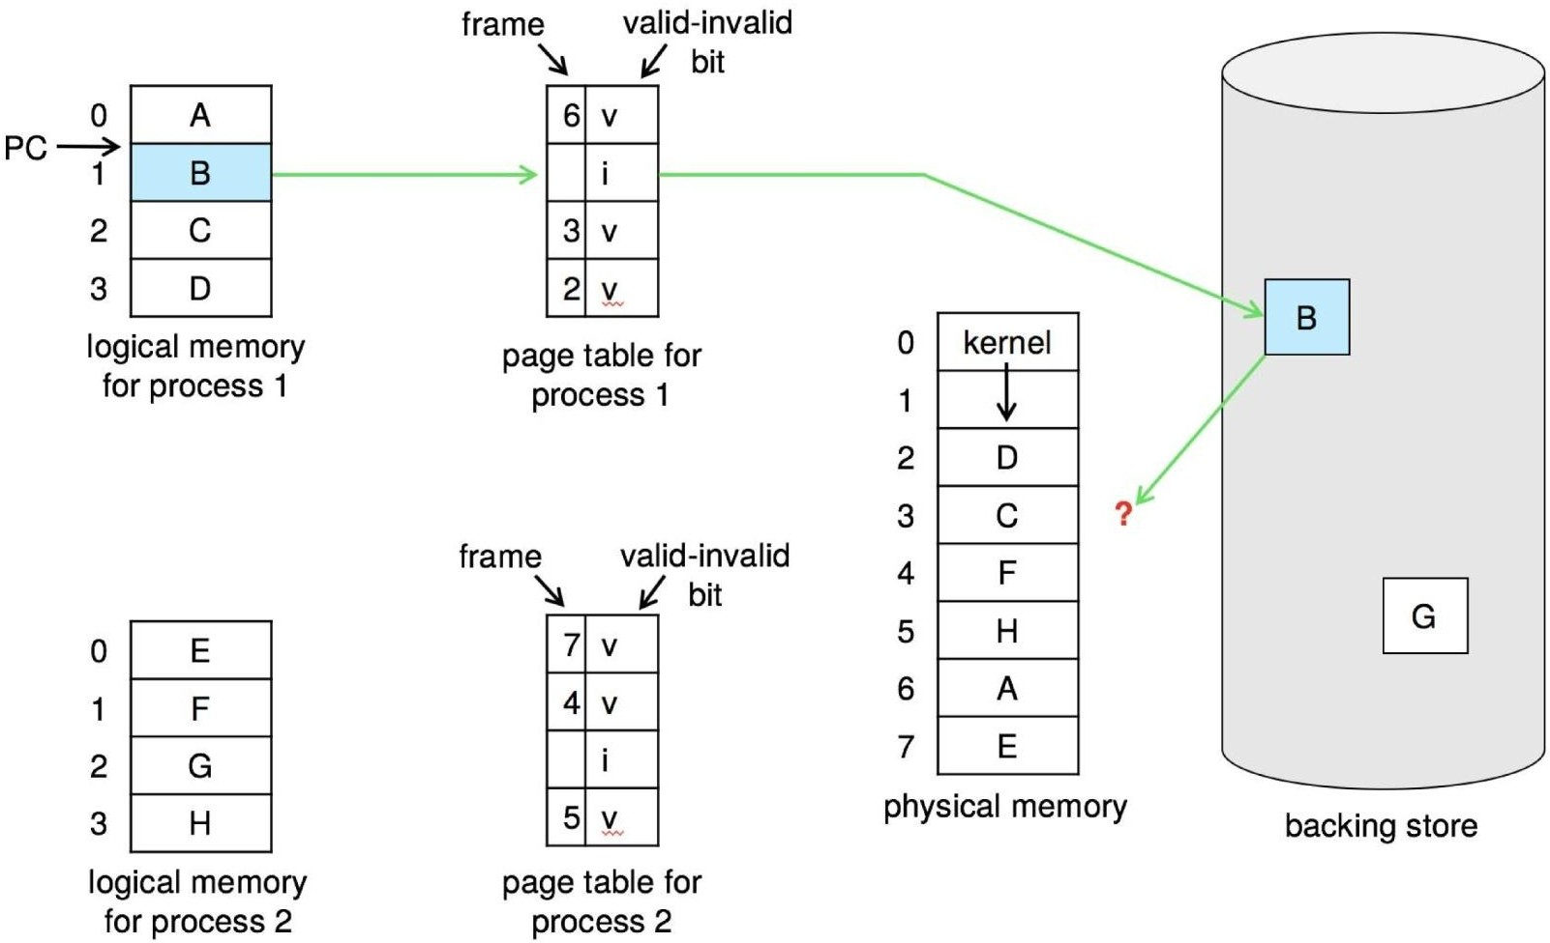
Need For Page Replacement

Slide 111
Page Replacement
Prevent over-allocation of memory by modifying page-fault service routine to include page replacement
It is the technique of swapping out pages from physical memory when there are no free frames available, in order to make room for other pages which has to be loaded to the physical memory
If a process wants to access a page which is not in memory, it will cause a page fault. Now, page has to be loaded into memory
Page replacement completes separation between logical memory and physical memory – large virtual memory can be provided on a smaller physical memory

Slide 112
Basic Page Replacement
Find the location of the desired page on disk
Find a free frame:
If there is a free frame, use it
If there is no free frame, use a page replacement algorithm to
select a victim frame
Write victim frame to disk if dirty
Bring the desired page into the (newly) free frame; update the page and frame tables
Continue the process by restarting the instruction that caused the trap. If no frames are free, two page transfers(one out and one in) are required. It increase the Effective Access Time. To reduce this time, make use of modify (dirty) bit. The modify bit is set when page has been modified.
If modify bit is set – It means that page has been modified and need to
write in the disk
If modify bit is not set – It means that page has not been modified and
no need to write in the disk. So it reduce Effective access Time.

Slide 113
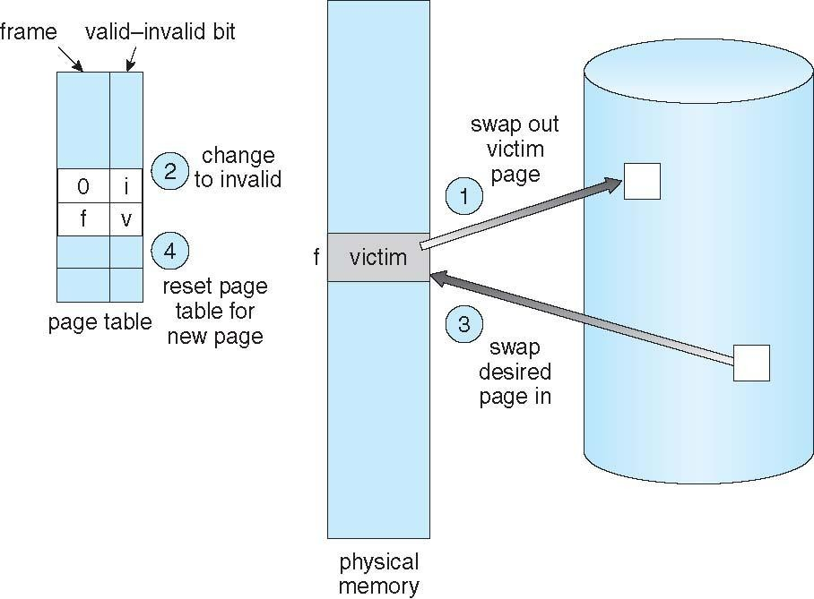
Page Replacement

Slide 114
Page and Frame Replacement Algorithms
Frame-allocation algorithm determines
How many frames to give each process
Which frames to replace
Page-replacement algorithm
Want lowest page-fault rate on both first access and re-access
Evaluate algorithm by running it on a particular string of memory references (reference string) and computing the number of page faults on that string
String is just page numbers, not full addresses
Repeated access to the same page does not cause a page fault
Results depend on number of frames available
In all our examples, the reference string of referenced page numbers is
7,0,1,2,0,3,0,4,2,3,0,3,0,3,2,1,2,0,1,7,0,1

Slide 115
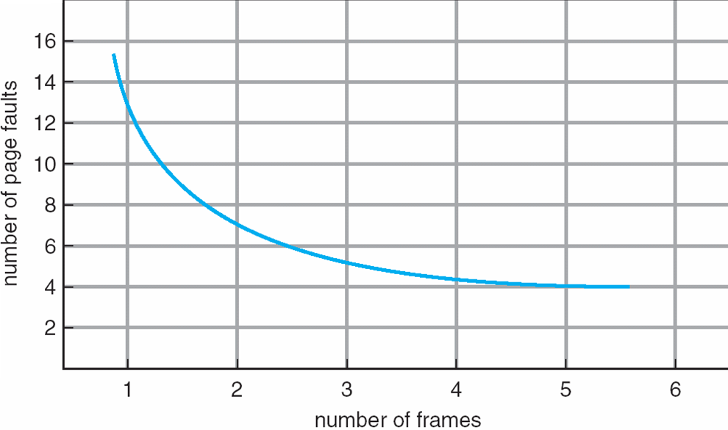
Graph of Page Faults Versus the Number of Frames

Slide 116
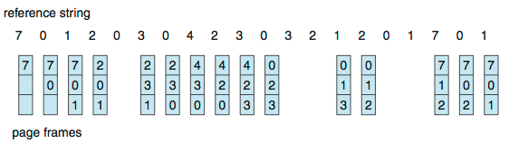
First-In-First-Out (FIFO) Algorithm
Reference string: 7,0,1,2,0,3,0,4,2,3,0,3,0,3,2,1,2,0,1,7,0,1
3 frames (3 pages can be in memory at a time per process)
15 page faults
Can vary by reference string: consider 1,2,3,4,1,2,5,1,2,3,4,5
Adding more frames can cause more page faults!
Belady’s Anomaly Advantage : Simple

Slide 117
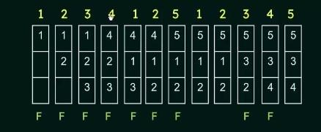
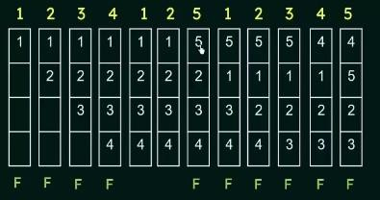
Consider 1,2,3,4,1,2,5,1,2,3,4,5 with 3 pages : 9 page faults
Consider 1,2,3,4,1,2,5,1,2,3,4,5 with 4 pages : 10 page faults

Slide 118





FIFO Illustrating Belady’s Anomaly
Consider 1,2,3,4,1,2,5,1,2,3,4,5 with more than 4pages: 5 page faults
Because the distinct values are 1,2,3,4,5

Slide 119
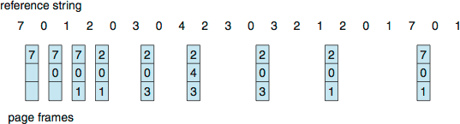
Optimal Algorithm
Replace page that will not be used for longest period of time
Never suffer from Belady‘s anomaly
Guarantees the lowest page fault rate
9 Page faults
Advantage : Page fault is low compared to all algorithms
Dis Advantages : No hardware support for implementation, Can’t read
the future

Slide 120
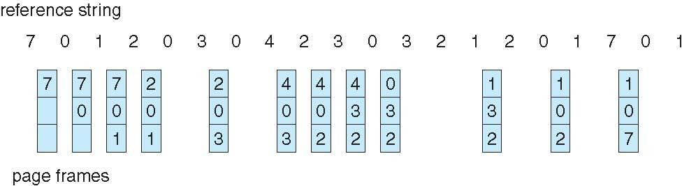
Least Recently Used (LRU) Algorithm
Use past knowledge rather than future
Replace page that has not been used in the most amount of time
Associate time of last use with each page
Better than FIFO but worse than OPT
Generally good algorithm and frequently used
12 Page faults

Slide 121
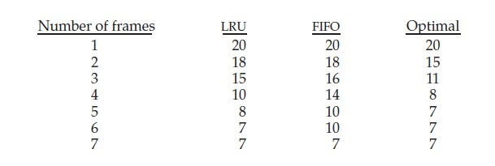
EX1 : Consider the following page reference string:
1, 2, 3, 4, 2, 1, 5, 6, 2, 1, 2, 3, 7, 6, 3, 2, 1, 2, 3, 6.
How many page faults would occur for the following replacement algorithms, assuming one, two, three, four, five, six, and seven frames? Remember that all frames are initially empty, so your first unique pages will cost one fault each.
LRU replacement
FIFO replacement
Optimal replacement

Slide 122
Ex2 : Consider the following page reference string:
7, 2, 3, 1, 2, 5, 3, 4, 6, 7, 7, 1, 0, 5, 4, 6, 2, 3, 0 , 1.
Assuming demand paging with three frames, how many page faults
would occur for the following replacement algorithms?
LRU replacement - 18
FIFO replacement - 17
Optimal replacement - 13

Slide 123
G1. Consider a computer system with ten physical page frames. The system is provided with an access sequence (a₁,a₂,…,a₂₀,a₁,a₂,…,a₂₀), where each a_{i} is a distinct virtual page number. The difference in the number of page faults between the last-in-ﬁrst-out page replacement policy and the optimal page replacement policy is .( GATE 2016)
A. 1 B.2 C.3 D.4
Calculate the difference between the last-in-first-out page replacement policy and the optimal page replacement policy.
First, Consider LIFO (Last In First Out) →a₁ to a₁₀ will result in page faults = 10 page faults. Then a₁₁ will replace a₁₀ (last in is a₁₀), a₁₂ replace a₁₁ and ...till a₂₀ = 10 page faults and a₂₀ will be top of stack and a₉…a₁ are remained as such. Then a₁ to a₉ are already there. So, 0 page faults from a₁ to a₉. a₁₀ will replace a₂₀, a₁₁ will replace a₁₀ and so on = So 11 page faults.
So total faults will be 10+10+11 = 31.

Slide 124
Second Optimal Page Replacement Policy →
a₁ to a₁₀ = 10 page faults, a₁₁ will replace a₁₀ because among a₁ to a₁₀, a₁₀ will be used later, a₁₂ will replace a₁₁ and so on = 10 page faults.
a₂₀ will be top of stack and a₉…a₁ are remained as such.
a₁ to a₉ = 0 page fault. a₁₀ will replace a₁ because it will not be used
afterwards and so on, a₁₀ to a₁₉ will have 10 page faults. So no page fault for a₂₀.
Total = 10+ 10 +10 = 30.
So the difference between LIFO - Optimal = 1
G2. Consider a main memory with five page frames and the following sequence of page references: 3, 8, 2, 3, 9, 1, 6, 3, 8, 9, 3, 6, 2, 1, 3. Which one of the following is true with respect to page replacement policies First-In-First Out (FIFO) and Least Recently Used (LRU)? ( GATE 2015)
A. Both incur the same number of page faults B. FIFO incurs 2 more page faults than LRU C. LRU incurs 2 more page faults than FIFO D. FIFO incurs 1 more page faults than LRU

Slide 125


Both LRU and FIFO have 9 page faults

Slide 126
G3. Assume that there are 3 page frames which are initially empty. If the page reference string is 1, 2, 3, 4, 2, 1, 5, 3, 2, 4, 6, the number of page faults using the optimal replacement policy is . (GATE 2014) A. 7 B.8 C.9 D.10
1 2
2 4 6
3 4 2 1 5 3
1 |  | 1 |  | 1 |  | 1 |  | 5 |  | 3 |  | 6
 |  | 2 |  | 2 |  | 2 |  | 2 |  | 2 |  | 2
 |  |  |  | 3 |  | 4 |  | 4 |  | 4 |  | 4
Total 7 faults

Slide 127
G4. Consider the virtual page reference string 1, 2, 3, 2, 4, 1, 3, 2, 4, 1 on a demand paged virtual memory system running on a computer system that main memory size of 3 pages frames which are initially empty. Let LRU, FIFO and OPTIMAL denote the number of page faults under the corresponding page replacements policy. Then (GATE 2012)
A. OPTIMAL < LRU < FIFO
C. OPTIMAL = LRU
FIFO
1 2 3 2
B. OPTIMAL < FIFO < LRU
D. OPTIMAL = FIFO
1 3 2
4
4
₁1
1
2
1
2
3
4
2
3
4
1
3
4
1
2
No. of page faults with FIFO = 6

Slide 128
OPTIMAL:
1 2
3
2 4
1
3 2
4
1
1 |  | 1 |  | 1 |  | 1 |  | 1
 |  | 2 |  | 2 |  | 4 |  | 4
 |  |  |  | 3 |  | 3 |  | 2
No. of page faults with OPTIMAL =5 LRU
1 2 3 2 4 1
3
2
4
1
1 |  | 1 |  | 1 |  | 4 |  | 4 |  | 4 |  | 2 |  | 2 |  | 2
 |  | 2 |  | 2 |  | 2 |  | 2 |  | 3 |  | 3 |  | 3 |  | 1
 |  |  |  | 3 |  | 3 |  | 1 |  | 1 |  | 1 |  | 4 |  | 4
No. of page faults with LRU = 9
∴ Optimal < FIFO < LRU

Slide 129
G5.A system uses FIFO policy for page replacement. It has 4 page frames with no pages loaded to begin with. The system first accesses 100 distinct pages in some order and then accesses the same 100 pages but now in the reverse order. How many page faults will
occur? | (GATE 2010)
A. 196 | B.192 | C.197 | D.195
The first 100 accesses causes 100 page faults for Page1 to Page100.Now, when they are accesses in reverse order page 100, 99, 98, 97 are already present. So 96 page faults for Page0 to Page 96. So, total of 196 page faults.
G6. A process has been allocated 3 page frames. Assume that none of the pages of the process are available in the memory initially. The process makes the following sequence of page references (reference string): 1, 2, 1, 3, 7, 4, 5, 6, 3, 1 If optimal page replacement policy is used, how many page faults occur for the above reference string? (GATE 2007)
A. 7 B.8 C.9 D.10

Slide 130
Using Optimal page replacement, 1 2 1 3 7
4
5
6
3
1
1 |  | 1 |  | 1 |  | 1 |  | 1 |  | 1 |  | 1
 |  | 2 |  | 2 |  | 7 |  | 4 |  | 5 |  | 6
 |  |  |  | 3 |  | 3 |  | 3 |  | 3 |  | 3
Total 7 page faults
G7. The address sequence generated by tracing a particular program executing in a pure demand paging system with 100 bytes per page is 0100, 0200, 0430, 0499, 0510, 0530, 0560, 0120, 0220,
0240, 0260, 0320, 0410. Suppose that the memory can store only one page and if x is the address which causes a page fault then the bytes from addresses x to x + 99 are loaded on to the memory. How many
page | faults | will | occur | ? | (GATE | 1995, | 2007)
(A)0 | (B)4 |  |  | (C) 7 |  | (D) 8

Slide 131
Page are fitted in frames, so first to determine the pages but given request is the record request in decimal. Assume that page1 to contain records from 0000 to 0099 and page 2 contains records from 0100 to 0199 and so on (it is given in question that each page contains 100 records) and so on. So page request string is 01, 02, 04, 04, 05, 05, 05,
01, 02, 02, 02, 03, 03. Clearly 7 page faults.
G8. Consider a demand paging system with four-page frames (initially empty) and an LRU page replacement policy. For the following page reference string 7, 2,7,3, 2,5,3, 4,6,7,7,1,5,6,1 the page fault rate, defined as the ratio of number of page faults to the number of memory accesses (rounded off to one decimal place) is . (GATE 2022)
A 1.5 B 0.5 C 0.6 D 0.8
String : 7,2,7,3,2,5,3,4,6,7,7,1,5,6,1
Page fault : 9
Number of Memory accesses : 15 [ String contain 15 references] thus page fault rate =9/15=0.6

Slide 132
G9. Which one of the following statements is FALSE? (GATE 2022)
The TLB performs an associative search in parallel on all its valid entries using page number of incoming virtual address.
If the virtual address of a word given by CPU has a TLB hit, but the subsequent search for the word results in a cache miss, then the word will always be present in the main memory.
The memory access time using a given inverted page table is
always same for all incoming virtual addresses.
In a system that uses hashed page tables, if two distinct virtual addresses V1 and V2 map to the same value while hashing, then the memory access time of these addresses will not be the same.
G10. Consider allocation of memory to a new process. Assume that none of the existing holes in the memory will exactly fit the process‘s memory requirement. Hence, a new hole of smaller size will be created if allocation is made in any of the existing holes. Which one of the following statement is TRUE ?(GATE 2020)

Slide 133
The hole created by first fit is always larger than the hole created by
next fit.
The hole created by worst fit is always larger than the hole created by
first fit.
The hole created by best fit is never larger than the hole created
by first fit.
The hole created by next fit is never larger than the hole created by
best fit.
G11. In which one of the following page replacement algorithms it is possible for the page fault rate to increase even when the number of allocated frames increases?
(A) LRU (Least Recently Used) (B) OPT (Optimal Page Replacement)
(C) MRU (Most Recently Used) (D) FIFO (First In First Out)
In some situations FIFO page replacement gives more page faults when increasing the number of page frames. This situation is Belady‘s anomaly.

Slide 134
LRU Algorithm Implementation
There are two ways to implement LRU ;
1.Using Counters 2. Using Stack
Counter implementation
Page Table Entry
Clock/
Counter
With each page table entry, associate a time of use field and add logical clock or counter to the CPU
The clock/counter is incremented for every memory reference
Whenever a reference to a page is made, the contents of the clock/counter
are copied to the time of use field in the page table entry for that page
So, always have the ‗ time/count‘ value of the last reference to each page
When a page needs to be changed, look at the counters to find
smallest value
Search through table needed
Frame No | Present /Absent | Prote ction | Refere nce | Cachi ng | Dirty | Time of Use

Slide 135
LRU Algorithm Implementation
Stack implementation
Maintain a stack of Page Numbers
Whenever a page is referenced, it is removed from the stack and put on the top
So, the most recently used page is always at the top of the stack and the least recently used page is always at the bottom
Since, entries must be removed from the middle of the stack, it is best to implement by using a doubly linked list with head and tail pointer
But each update more expensive
No search for replacement

Slide 136



LRU Algorithm (Cont.)
LRU and OPT are cases of stack algorithms that don’t have Belady’s Anomaly

Slide 137
LRU Approximation Page Replacement Algorithms
LRU needs special hardware and still slow
Many systems provide support for LRU in the form of Reference bit Steps:
Initially, the OS sets all the reference bits for all the pages to ‗0‘
Whenever a page is referenced, the reference bit set as ‗1‘
By checking these reference bits, know about which pages have been
used and which haven‘t been used
But, do not determine the order of use - For this use Additional- Reference-Bits Algorithm

Slide 138
LRU approximation algorithm –Additional Reference Bits Algorithm
Additional ordering information by recording the reference bits at regular intervals.
Keep an 8-bit byte for each page in a table in memory.
At regular intervals (say, every 100 milliseconds), a timer interrupt
transfers control to the operating system.
The operating system shifts the reference bit for each page into the high-order bit of its 8-bit byte, shifting the other bits right by 1 bit and discarding the low-order bit.
These 8-bit shift registers contain the history of page use for the last
eight time periods
Page No | Shift Register Content | What it means
P1 | 00000000 | This page has not been used for eight time periods
P2 | 11111111 | The page has been used atleast once in each period
P3 | 11000100 | The page has been used more recently than P4
P4 | 01110111 | The page has been used less recently than P3

Slide 139
Interpret these 8-bit bytes as unsigned integers, the page with the
lowest number is the LRU page, and it can be replaced.
Note that the numbers are not guaranteed to be unique however, either replace (swap out) all pages with the smallest value or use the FIFO method to choose among them.
The number of bits of history included in the shift register can be varied, and is selected (depending on the hardware available) to make the updating as fast as possible.
In the extreme case, the number can be reduced to zero, leaving only the reference bit itself. This algorithm is called the second chance page- replacement algorithm

Slide 140
LRU Approximation Algorithms -Second-chance algorithm
Basic algorithm of second-chance replacement is a FIFO replacement algorithm.
When a page has been selected, check its reference bit. If the value is
0, proceed to replace this page;
But if the reference bit is set to 1, give the page a second chance and move on to select the next FIFO page.
When a page gets a second chance, its reference bit is cleared, and its arrival time is reset to the current time.
Thus, a page that is given a second chance will not be replaced until
all other pages have been replaced (or given second chances).
In addition, if a page is used often enough to keep its reference bit set, it will never be replaced.

Slide 141





Second-chance Algorithm Implementation

Slide 142
Implement the second-chance algorithm (sometimes referred to as the
clock algorithm) is as a circular queue.
A pointer (that is, a hand on the clock) indicates which page is to be
replaced next.
When a frame is needed, the pointer advances until it finds a page with a 0 reference bit. As it advances, it clears the reference bits .
Once a victim page is found, the page is replaced, and the new page is inserted in the circular queue in that position.
In the worst case, when all bits are set, the pointer cycles through the
whole queue, giving each page a second chance.
It clears all the reference bits before selecting the next page for replacement.
Dis Advantage: Second-chance replacement degenerates to FIFO replacement if all bits are set

Slide 143
Enhanced Second-Chance Algorithm
Consider both Reference bit and the Modify bit as an ordered pair.
Modify bit is set when page is modified Reference bit is set when a page is referenced
Four possible cases
Order ed pair | Refere nce bit | Modi fy bit | What it means | Remarks
(0,0) | 0 | 0 | The page was neither used recently nor modified | Best page to replace
(0,1) | 0 | 1 | The page was not used recently, but it has been modified | Not the best page to be replaced, because to write this page to disk when replacement is done

Slide 144
(1,0) | 1 | 0 | The page was used recently but not modified | There are chances that this page will be used again soon
(1,1) | 1 | 1 | The page was used recently and also has been modified | There are chances that this page will be used again and write this page to disk when replacement is done
Each page is in one of these four classes.
When page replacement is called for, use the same scheme as in the clock algorithm; but instead of examining whether the page is pointing to the reference , examine the class to which that page belongs.

Slide 145
Counting Algorithms
Keep a counter of the number of references that have been made to each page
Least Frequently Used (LFU) Algorithm:
Replaces page with smallest count
Most Frequently Used (MFU) Algorithm:
Based on the argument that the page with the smallest count was
probably just brought in and has yet to be used

Slide 146
Page-Buffering Algorithms
Keep a pool of free frames:
When a page fault occurs, a victim frame is chosen as before.
The desired page is read into a free frame from the pool before
the victim is written out.
This procedure allows the process to restart as soon as possible, without waiting for the victim page to be written out.
When the victim is later written out, its frame is added to the free-frame pool.
▪
▪
▪
There are two ways of modifications in the algorithm:
First Method : To maintain a list of modified pages.
Whenever the paging device is idle, a modified page is selected and is written to secondary storage. Its modify bit is then reset.
This scheme increases the probability that a page will be clean when it is selected for replacement and will not need to be written out

Slide 147
Second Method : Keep a pool of free frames but to remember which
page was in each frame.
Since the frame contents are not modified when a frame is written to secondary storage, the old page can be reused directly from the free- frame pool if it is needed before that frame is reused.
No I/O is needed in this case. When a page fault occurs, first check whether the desired page is in the free-frame pool. If it is not, then select a free frame and read into it.

Slide 148

Thrashing

Slide 149
If a process is spending more time in paging rather than in executing,
then the process is Thrashing.
Cause of Thrashing - severe performance problems
The operating system monitors CPU utilization. If CPU utilization is too low, so increase the degree of multiprogramming by introducing a new process to the system.
A page-replacement algorithm is used; it replaces pages for the new
processes. It starts faulting and taking frames away from other processes.
These faulting processes must use the paging device to swap pages in and out. As they queue up for the paging device, the ready queue empties.
As processes wait for the paging device, CPU utilization decreases further.
Thrashing occurs, the system throughput also decreasing tremendously.

Slide 150

Thrashing (Cont.)
Thrashing: A process is busy swapping pages in and out

Slide 151
Working-Set Model
To prevent Thrashing , provide a process with as many frames as it needs.
To know about the number of frames needed for each process is by using Working Set Model.
This strategy checks how many frames a process is actually using. This approach defines the locality model of process execution.
The locality model states that, as a process executes, it moves from
locality to locality.
A locality is a set of pages that are actively used together. A running program is generally composed of several different localities, which may overlap.
For example, when a function is called, it defines a new locality .In this locality, memory references are made to the instructions of the function call, its local variables, and a subset of the global variables. When exit the function, the process leaves this locality, since the local variables and instructions of the function are no longer in active use.

Slide 152

Implementation : Use a parameter Δ which defines the working set window. The idea is to examine the most recent Δ page references. The set of pages in the most recent Δ page references is the working set .
If a page is in active use, it will be in the working set.
If it is no longer being used, it will drop from the working set Δ time
units after its last reference.
Thus, the working set is an approximation of the program‘s locality.
For example, given the sequence of memory references,
if Δ = 10 memory references, then the working set at time t1 is {1, 2, 5, 6, 7}. By time t2, the working set has changed to {3, 4}.

Slide 153
The accuracy of the working set depends on the selection of Δ.
If Δ is too small, it will not cover the entire locality; If Δ is too large, it may overlap several localities.
If Δ is infinite, the working set is the set of pages touched during the process execution.
The most important property of the working set is its size. If compute the working-set size, WSSi [ process ‗i‘ needs WSSi number of frames], for each process in the system.
So, total demand for frames in a system will be D = Σ WSSi
From the example, D= WSS1 + WSS2 = 5+2= 7 frames required
If the total demand is greater than the total number of available frames
(D>m), then thrashing will occur.
In this case, the OS will select a process to suspend. The process pages are swapped out and its frames are reallocated to other processes. The suspended process can be restarted later.
The working set model prevents thrashing while keeping the degree of multiprogramming as high as possible. So, CPU utilization is improved.

Slide 154
Page-Fault Frequency
The working-set model is successful, and knowledge of the working set can be useful for prepaging but it seems a clumsy way to control thrashing.
A strategy that uses the page-fault frequency (PFF) takes a more
direct approach.
The specific problem is how to prevent thrashing. Thrashing has a high page-fault rate. Thus, to control the page-fault rate.
When it is too high, that the process needs more frames.
Conversely, if the pagefault rate is too low, then the process have too
many frames.
So, establish upper and lower bounds on the desired page-fault rate.
If the actual page-fault rate exceeds the upper limit, allocate the process another frame.
If the page-fault rate falls below the lower limit, remove a frame from the process. Thus, we can directly measure and control the pagefault rate to prevent thrashing.

Slide 155










Page-Fault Frequency

Slide 156
G12.Consider a logical address space of 8 pages of 1024 words each, mapped onto a physical memory of 32 frames. How many bits are there in the physical address and logical address respectively?(GATE 2013) (A)5,3 (B)10,10 (C)15,13 (D) 15, 15
Logical address space has 8 pages, size of each page, offset = 1024 words Number if bits in page# field of the logical address = log₂8 bits = 3 bits Offset bits = log₂1024 = 10 bits
So, Logical address = 3 + 10 = 13 bits
Physical memory has 32 frames, offset = 1024 words
Number of bits in frame# field of the Physical address = log₂32 bits = 5 bits
Physical address = 5 + 10 = 15 bits

Slide 157
EX1: Assuming a 1-KB page size, what are the page numbers and offsets for the following address references (provided as decimal numbers)
a. 3085
b. 42095 c. 215201 d. 650000 e.2000001
g. 8902
f. 10945
page size = 1 KB = 1024bytes
Page Number | Offset
3085/1024 = 3 | 3085 mod 1024 = 13
42095/1024 = 41 | 42095 mod 1024 = 111
215201/1024 = 210 | 215201 mod1024 = 161
650000/1024 = 634 | 650000 mod 1024 =784
2000001/1024 =1953 | 2000001mod 1024 = 129
10945/1024 = 10 | 10945 mod 1024= 705
8902/1024 = 8 | 8902 mod 1024 = 710

Slide 158
EX2. Consider a logical address space of 64 pages of 1,024 words
each, mapped onto a physical memory of 32 frames. a.How many bits are there in the logical address? b.How many bits are there in the physical address?
Logical address space has 64pages, size of each page, offset = 1024 words Number if bits in page# field of the logical address = log₂64 bits = 6 bits Offset bits = log₂1024 = 10 bits
So, Logical address = 6 + 10 = 16 bits
Physical memory has 32 frames, offset = 1024 words
Number of bits in frame# field of the Physical address = log₂32 bits = 5 bits
Physical address = 5 + 10 = 15 bits

Slide 159
EX3: The BTV operating system has a 21-bit virtual address, yet on certain embedded devices, it has only a 16-bit physical address. It also has a 2-KB page size.
How many entries are there in each of the following? What is the maximum amount of physical memory in the BTV operating system?
A conventional, single-level page table
An inverted page table
Consider a logical address space of 256 pages with a 4-KB page size, mapped onto a physical memory of 64 frames.
How many bits are required in the logical address? How many bits are required in the physical address?
a. i. Conventional, single-level page table will have 2¹⁰ = 1024 entries.
ii. Inverted page table will have 2⁵ = 32 entries.
The maximum amount of physical memory is 2¹⁶ = 65536 (or 64 KB.)

Slide 160
b. Logical address space has 256pages, size of each page =4KB Number if bits in page# field of the logical address = log₂256 bits = 8 bits
Offset bits = log₂ (4×1024) = 12 bits So, Logical address = 8 + 12 = 20 bits
Physical memory has 64 frames, offset = 1024 words
Number of bits in frame# field of the Physical address = log₂64 bits = 6 bits
Physical address = 6 + 12 = 18 bits

Slide 161
Ex4:Consider a computer system with a 32-bit logical address and 4- KB page size. The system supports up to 512 MB of physical memory. How many entries are there in each of the following?
A conventional, single-level page table
An inverted page table
2²⁰ entries.
Entries = Physical memory size/ page size
=512 ×2²⁰ /4 ×2¹⁰ = 128 ×2¹⁰ = 128K entries.
Ex5: Consider the following page-replacement algorithms. Rank these algorithms on a five-point scale from ―bad‖ to ―perfect‖ according to their page-fault rate. Separate those algorithms that suffer from Belady‘s anomaly from those that do not.
LRU replacement FIFO replacement Optimal replacement
Second-chance replacement

Slide 162
Rank | Algorithm | Belady‘s anomaly
1 | Optimal | No
2 | LRU replacement | No
3 | Second-chance replacement | Yes
4 | FIFO replacement | Yes
Ex6: Consider the given page table for a system with 12-bit virtual and physical addresses and 256-byte pages. The list of free page frames is D, E, F (that is, D is at the head of the list, E is second, and F is last). A dash for a page frame indicates that the page is not in memory. Convert the following virtual addresses to their equivalent physical addresses in hexadecimal. All numbers are given in hexadecimal.
9EF
111
700
0FF

Slide 163
It is given that virtual address is 12 bit long. Hence, there are 2¹² addresses in the virtual address space.
Page Size is given 256bytes = 2⁸ Number of pages = 2¹² / 2⁸ = 2⁴
To address each page 4 bits are required.
The most significant 4 bits in the virtual address will denote the page number being referred and the remaining 8 bits will be the page offset.
Page size is same as the frame size. Hence the last 8 bits will remain same in the physical address as that of the virtual address.
To get the frame address in the main memory use
the first 4 bits.
The virtual address 9EF, 9 denotes the page number (1001 ) and corresponding frame no is 0 ( 0000 from given table).Hence the resulting physical address will be 0EF.
Similarly, 111 → 211 , 700 → D00 , 0FF → EFF
Page | Page Frame
0 | –
1 | 2
2 | C
3 | A
4 | –
5 | 4
6 | 3
7 | –
8 | B
9 | 0

